Slide 1
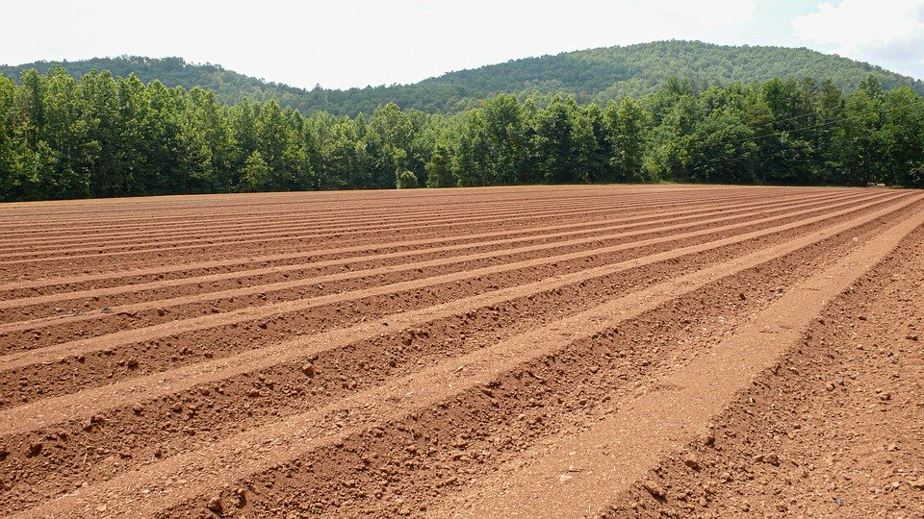
DURING THE OX-PLOW STAGE

Slide 2
1 After the sealing, there’ll be a delay,
After the delay, the six angels will slay;
After the slaughter, there’ll be an outpouring,
Following this outpouring, the oxen will start plowing.
Chorus: During the Ox-plow stage, when, at this appointed time,
In Laodicea the servants preach truth so sublime,
Thousands will freely embrace the Truth,
To join themselves to the vanguard,
Thousands will freely embrace the Truth,
The number completed; all will be glad.

Slide 3
2 The mattock-like work, will so soon gain speed,
Into ox-plow stage, ‘twill emerge as decreed,
The ground broken up, the vineyard restored,
All the believers, then will be of one accord.
Chorus: During the Ox-plow stage, when, at this appointed time,
In Laodicea the servants preach truth so sublime,
Thousands will freely embrace the Truth,
To join themselves to the vanguard,
Thousands will freely embrace the Truth,
The number completed; all will be glad.

Slide 4
3 Lord grant me a chance, in order to march,
With the soldiers brave, who’ll go to mother church,
After the five months, together we’ll sing,
The church is reclaimed, all glory unto the King!
Chorus: During the Ox-plow stage, when, at this appointed time,
In Laodicea the servants preach truth so sublime,
Thousands will freely embrace the Truth,
To join themselves to the vanguard,
Thousands will freely embrace the Truth,
The number completed; all will be glad.

