Slide 1
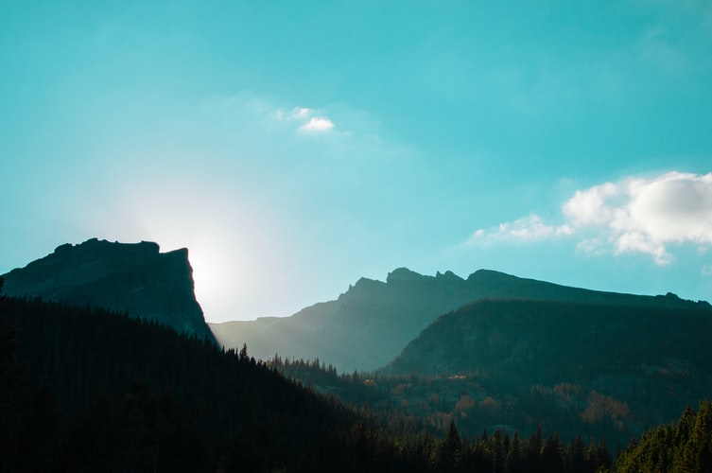
GOD BEGAN WITH ONLY ONE MAN

Slide 2
1
God began with only one man,
He has hundreds at this time,
Soon He’ll have twenty-four thousand,
Spirit filled servants sublime.
Won’t you quickly come and join them:
The Vanguard - First of firstfruits?
Who from Israel are to gather,
The second of firstfruit saints.

Slide 3
2
After the day of Reckoning,
The Eleventh Hour Church,
Will be free from foolish virgins,
And the wise will onward march.
How graceful is this map of truth,
Unfolded by Christ Jesus,
We will have one chosen shepherd,
Who will be king over us.

Slide 4
3
Judas, Achan and Abiram,
Will be trampled underfoot,
Since the Rod they have retarded,
In them, it cannot take root.
Loud and clear the Lord is calling,
Get ready, now pray and watch,
Christ is coming soon to reckon,
First with the Davidian church.

Slide 5
4
Though the work be slow at present,
‘Twill gain speed, the Lord declares,
The treading of lesser cattle,
Will get rid of all the tares.
Soon the Vanguard workers of God,
In hundred and fifty days,
Will preach quickly to our brethren,
Thousands will amend their ways.

