Slide 1
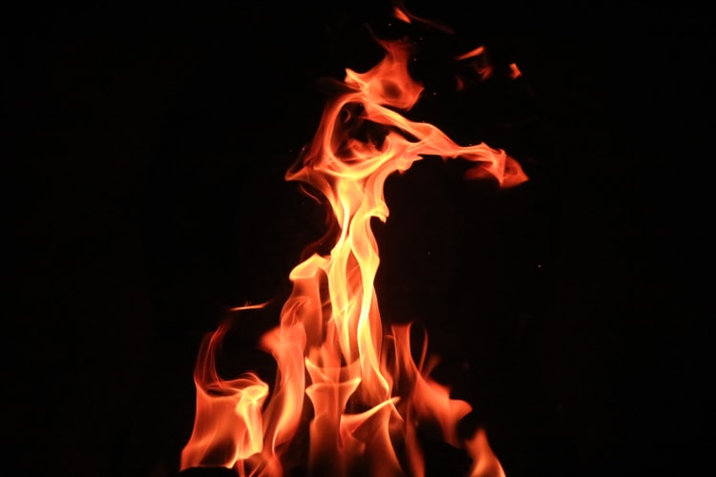
Holy Spirit You Are
My Only Hope

Slide 2
1 Holy Spirit you are my only hope,
I depend on your guidance in this life.
Will I from the slaughter weapons escape?
Help me to have no guile and so be safe.
Chorus: Holy Spirit, Holy Spirit,
You lead us into all Truth,
Bless us with a faith implicit,
Like that of Abraham.

Slide 3
2 It is present truth that we need today,
Given to the flock of God through David.
Let nobody make you to stray away,
The day of reckoning comes, oh take heed!
Chorus: Holy Spirit, Holy Spirit,
You lead us into all Truth,
Bless us with a faith implicit,
Like that of Abraham.

Slide 4
3 Opposition is our lot brethren,
As it was to Luther the reformer.
Help us, Spirit, that we be not barren,
Rather, much fruit for the garner to bear.
Chorus: Holy Spirit, Holy Spirit,
You lead us into all Truth,
Bless us with a faith implicit,
Like that of Abraham.

Slide 5
4 Love, joy, peace, longsuffering, gentleness,
Goodness, faithfulness, meekness, temperance,
These will enable us obtain fitness,
Into the Kingdom for to gain entrance.
Chorus: Holy Spirit, Holy Spirit,
You lead us into all Truth,
Bless us with a faith implicit,
Like that of Abraham.

Slide 6
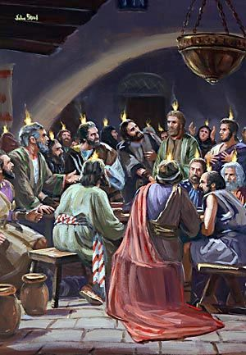
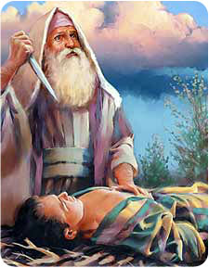
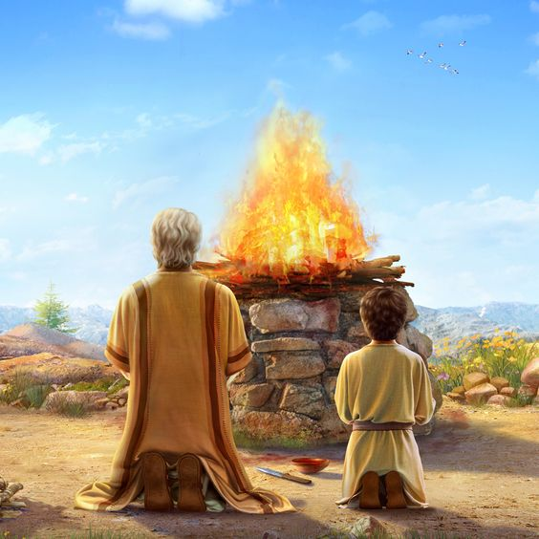
Chorus: Holy Spirit, Holy Spirit,
You lead us into all Truth,
Bless us with a faith implicit,
Like that of Abraham.

