Slide 1
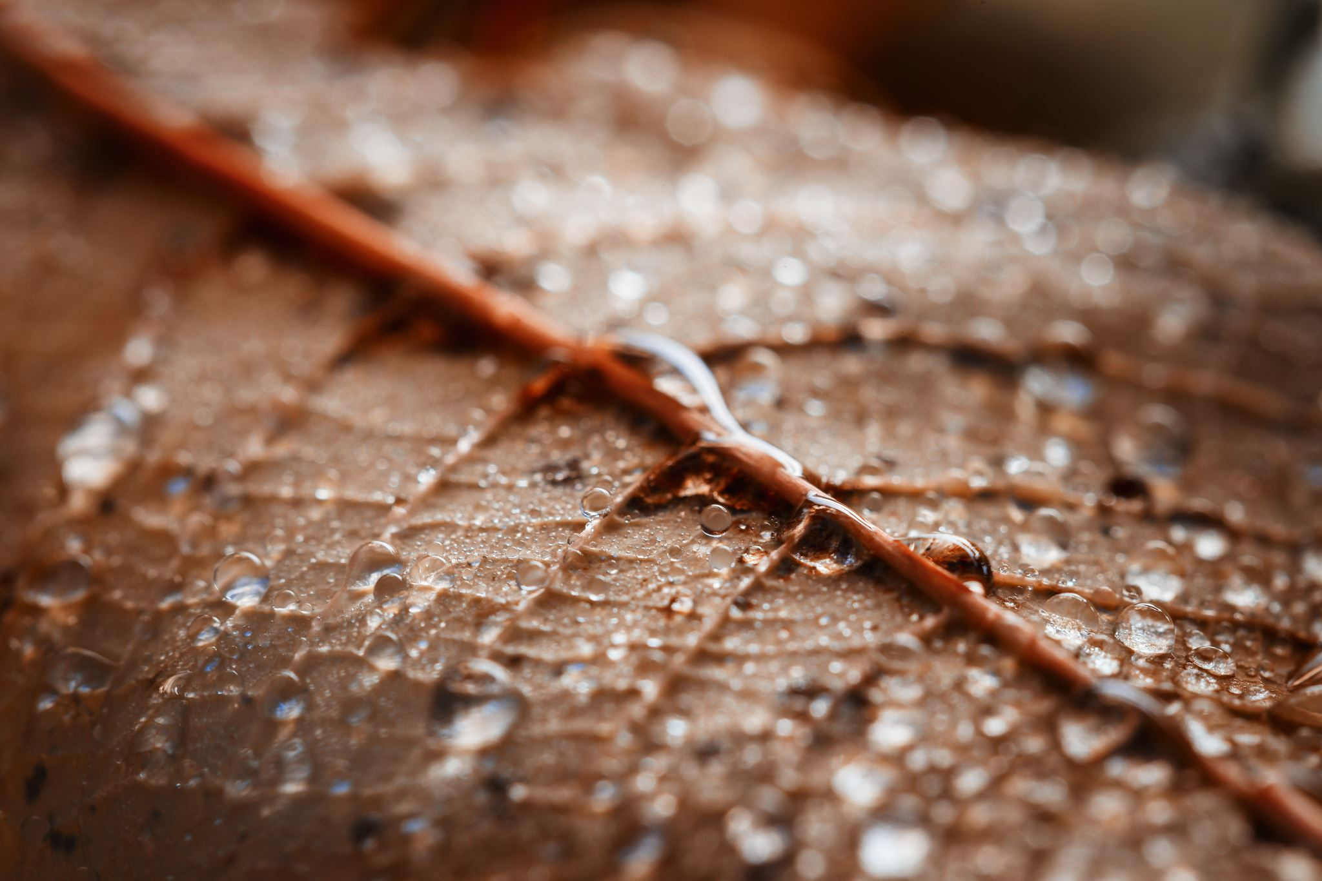
I WANT TO BE A DANIEL

Slide 2
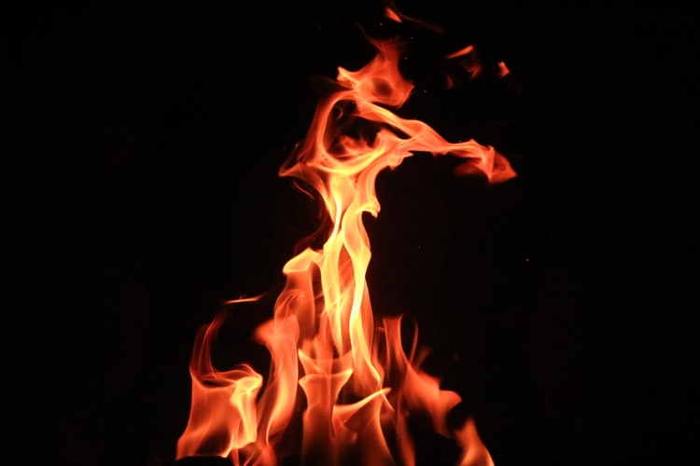
1 I want to be a Daniel,
I want to be a Job,
I want to be a Stephen,
I want to be a Luther,
I want to be a Miller,
I want to be a White.
Chorus: Yes, a Davidian,
A genius to see truth,
Yes, a true Christian,
Striving for righteousness.

Slide 3
2 I won’t be an Ananias,
I will not be a Saul,
I won’t be a Sadducee,
I won’t be a Pharisee,
I will not be a Judas,
I will not be a Cain.
Chorus: No, No, Not a Scribe,
A genius to find fault,
No, Not a Pharisee,
Too blind to see the Truth.

Slide 4
3 I would be a Deborah,
I would be an Esther,
I want to be a Mary,
I want to be a Dorcas,
I would be a Salome,
I want to be a Ruth.
Chorus: Yes, a Davidian,
A genius to see truth,
Yes, a true Christian,
Striving for righteousness.

Slide 5
4 I won’t be a Jezebel,
I won’t be a Michal,
I won’t be a Sapphira,
I won’t be a Delilah,
I won’t be a Peninah,
I won’t be an Orpah.
Chorus: No, No, Not a Scribe,
A genius to find fault,
No, Not a Pharisee,
Too blind to see the Truth.

Slide 6
Chorus: Yes, a Davidian,
A genius to see truth,
Yes, a true Christian,
Striving for righteousness.

