Slide 1

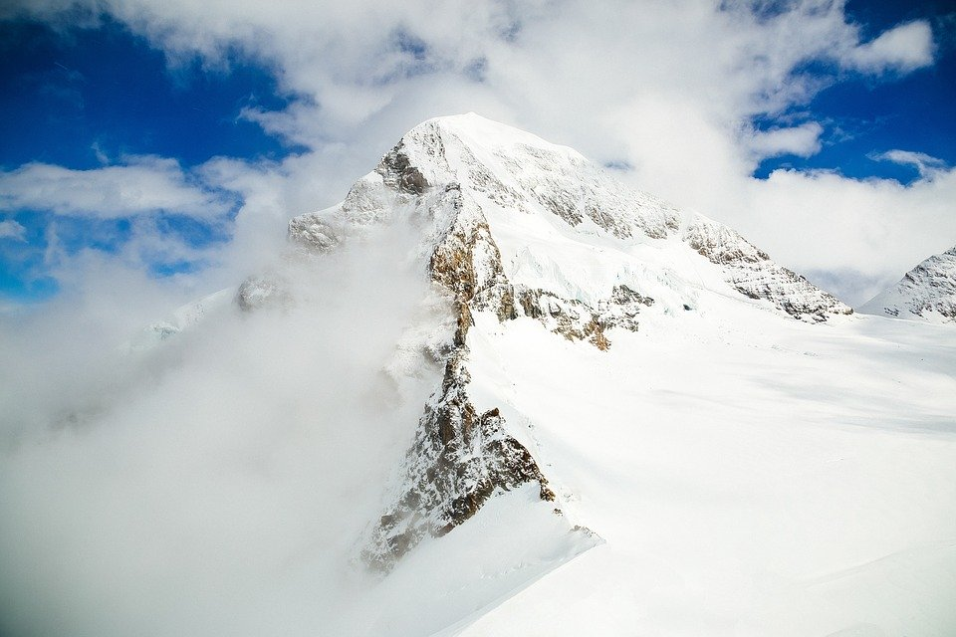
LOOK TO THE CROSS

Slide 2
1
The Lord has begun, with only one man,
And is gathering Benjamin and Judah,
They'll conquer mother church,
Ten tribes sing hosanna,
As simple means bring in the defeat of Satan.

Slide 3
Chorus:
Brothers:
My brother...
Sister...
He is...
And He will...
Then let us...
Knowing...
If we...
Chorus:
Sisters:
Do you have a wedding garment?
Look to the cross of Jesus,
All our righteousness,
Wash us white as snow,
Go before the throne with boldness,
To the very end He's with us,
As the workers for this hour...
Together:
Keep His commandment.

Slide 4
2
The work is mattock-like, our progress is slow,
But it will spring up into the ox-plow stage,
All virgins who are wise,
The chariot shall manage,
And no inferior cattle will the Lord allow.

Slide 5
Chorus:
Brothers:
My brother...
Sister...
He is...
And He will...
Then let us...
Knowing...
If we...
Chorus:
Sisters:
Do you have a wedding garment?
Look to the cross of Jesus,
All our righteousness,
Wash us white as snow,
Go before the throne with boldness,
To the very end He's with us,
As the workers for this hour...
Together:
Keep His commandment.

Slide 6
3
A flesh heart you'll get, and never sin again,
Forces of Gentiles come humbly, unto thee,
You'll move and fall on swords,
No wound shall injure thee,
As rejoicing the second fruit yield you obtain.

Slide 7
Chorus:
Brothers:
My brother...
Sister...
He is...
And He will...
Then let us...
Knowing...
If we...
Chorus:
Sisters:
Do you have a wedding garment?
Look to the cross of Jesus,
All our righteousness,
Wash us white as snow,
Go before the throne with boldness,
To the very end He's with us,
As the workers for this hour...
Together:
Keep His commandment.

