Slide 1
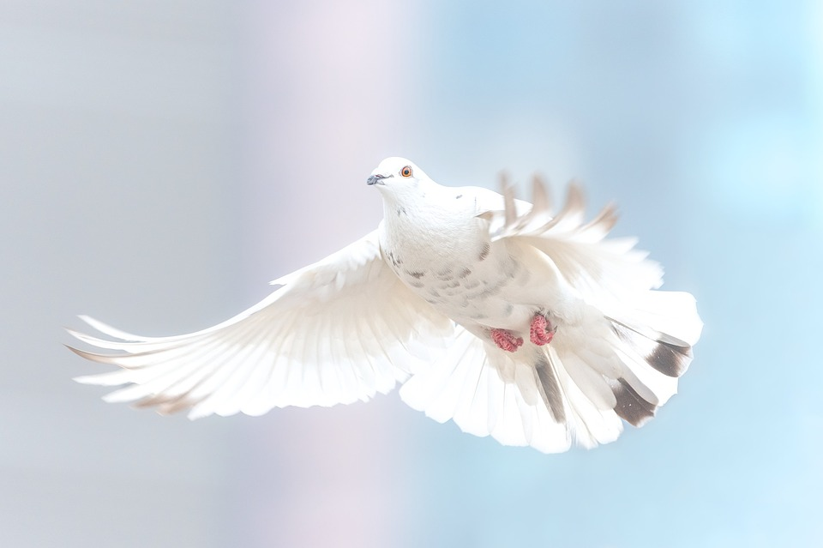
NEVER DWELL IN SIN

Slide 2
1 There is a place of truth and light,
Zion city of God;
All people there will know the Lord,
There will be much delight.

Slide 3
Chorus: The Lord will choose Jerusalem,
And Zion will get a new name,
And we His Church He’ll purify,
We’ll never, never dwell in sin.
What! Never dwell in sin?
No, never dwell in sin.
What! Never dwell in sin?
No, never dwell in sin.
His precious name He’ll glorify,
We’ll never, never dwell in sin.

Slide 4
2 Upon this earth judgment He brings,
Henceforth God takes the reins,
The first of first fruits He then gains,
And ox-plow stage begins.

Slide 5
Chorus: The Lord will choose Jerusalem,
And Zion will get a new name,
And we His Church He’ll purify,
We’ll never, never dwell in sin.
What! Never dwell in sin?
No, never dwell in sin.
What! Never dwell in sin?
No, never dwell in sin.
His precious name He’ll glorify,
We’ll never, never dwell in sin.

Slide 6
3 One shepherd, David, will then rule,
He’s one of the living,
God’s simple means, visible king,
With the Rod as his tool.

Slide 7
Chorus: The Lord will choose Jerusalem,
And Zion will get a new name,
And we His Church He’ll purify,
We’ll never, never dwell in sin.
What! Never dwell in sin?
No, never dwell in sin.
What! Never dwell in sin?
No, never dwell in sin.
His precious name He’ll glorify,
We’ll never, never dwell in sin.

