Slide 1
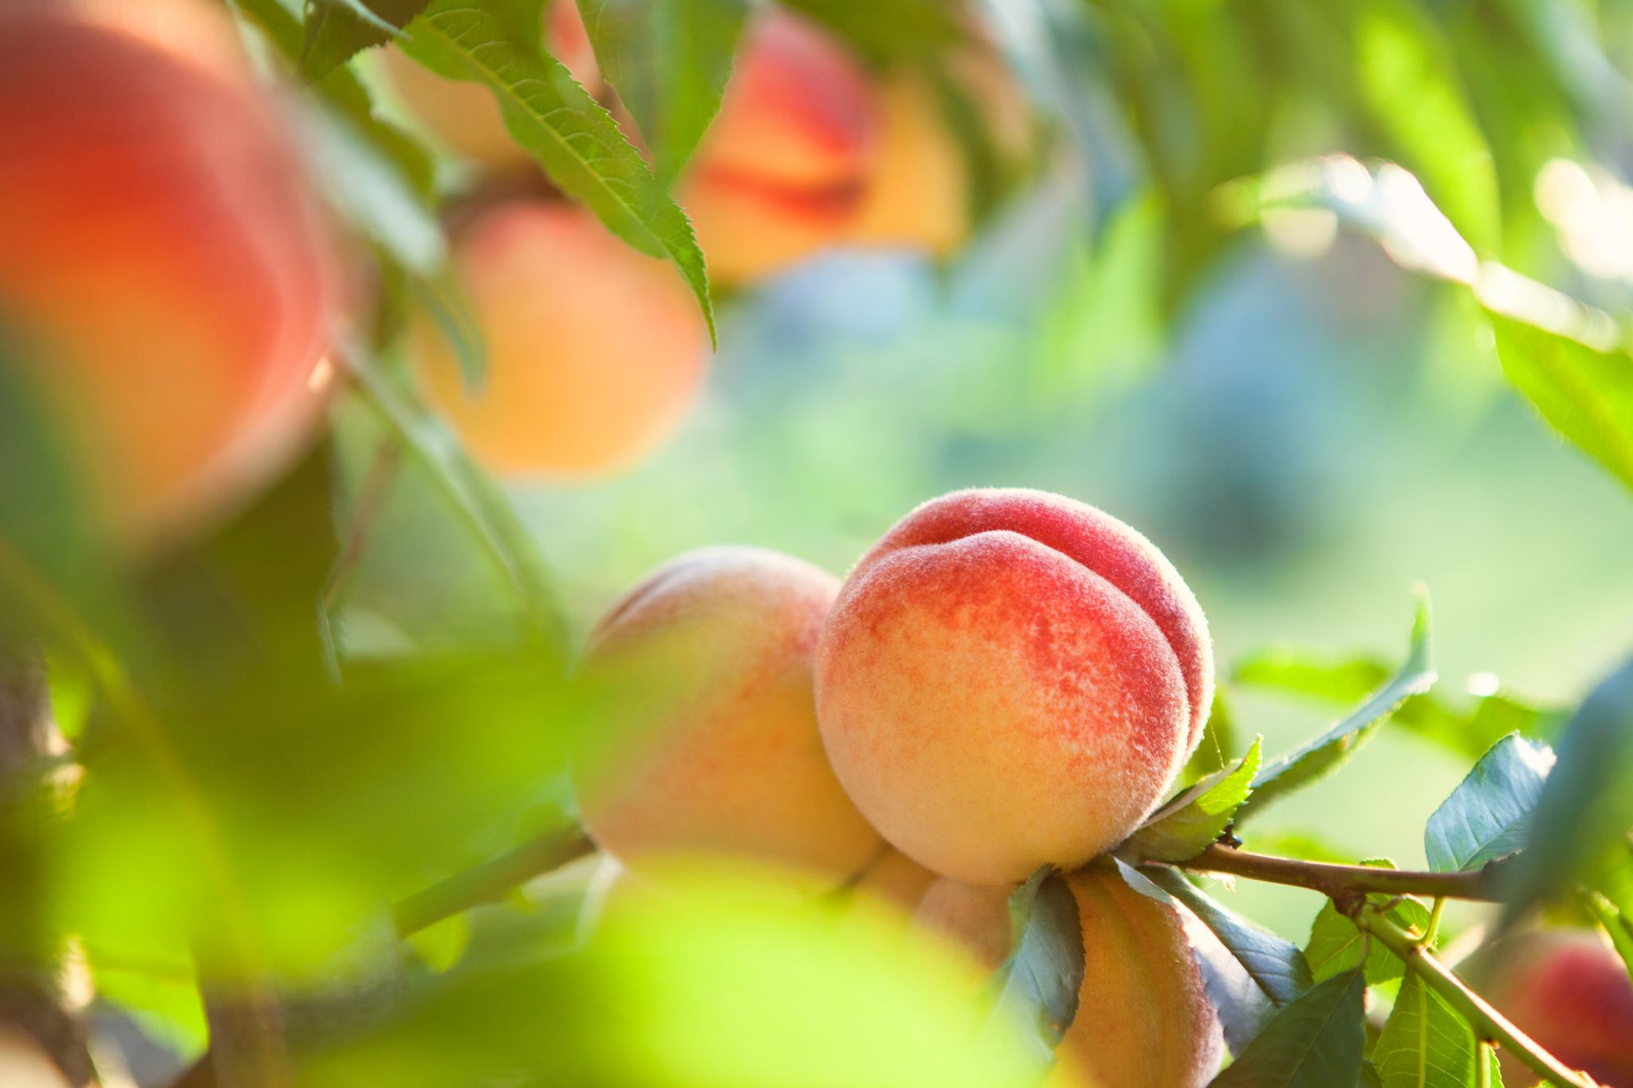
PRAISE THE LORD ALL YE DAVIDIANS

Slide 2
1
Praise the Lord all ye Davidians;
Oh sing praises unto Him;
He has brought the Rod for guidance,
Reformation is the theme.
Praise the Lord for He has kept us;
From the mire of Babel,
Praise the Lord, for He is with us;
And His Name Immanuel.

Slide 3
2
Praise the Lord all ye Davidians;
Oh sing praises unto Him;
All the saints are granted entrance,
Into the Kingdom supreme.
Praise the Lord for we are saviours;
To and of Laodicea;
Praise the Lord, Our God of favours,
He alone we should revere.

Slide 4
3
Praise the Lord all ye Davidians;
Oh sing praises unto Him;
Praise is comely and brings radiance,
Join the hymns of Seraphim.
Praise the Lord with harp and psalt’ry;
For all things He will restore,
Praise the Lord in sacred poetry,
Bless His Name forevermore.

