Slide 1

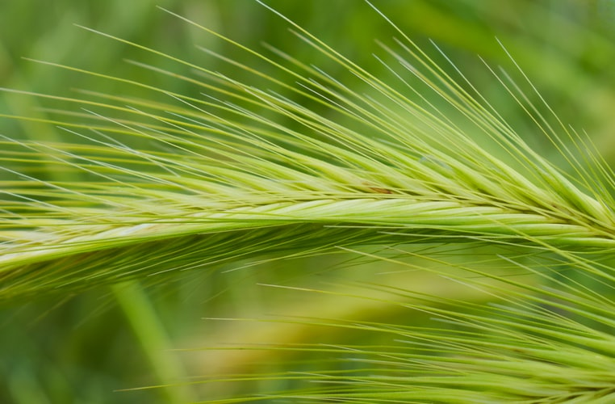
RIPE FOR HARVEST

Slide 2
1
Many fields are ripe for harvest,
They have not been entered yet,
For a lack of self-denying,
Helpers at this hour so late.
Hear the Lord is calling us to bear the light,
Perishing souls, get ready and do the right.

Slide 3
2
Our Theme now is soul winning,
Reaching earth’s inhabitants,
Starting with the first of first fruits,
Twenty-four thousand Servants.
Then the army of the vanguard will come in,
And the vineyard will at last be free from sin.

Slide 4
3
Crucify self, look to Jesus,
Hear Him like the Bereans,
And He be known, seen and be heard,
Among us Davidians.
He is calling us to do deep heart searching,
Seek and know Him, then we may do soul winning.

Slide 5
4
In that day so great and dreadful,
Tares bitterly cry out:
Harvest is past, summer ended,
We’re not saved; we are cast out!
O ye faithful, don’t forget to watch and pray,
For the pilgrims it will be so great a day.

