Slide 1
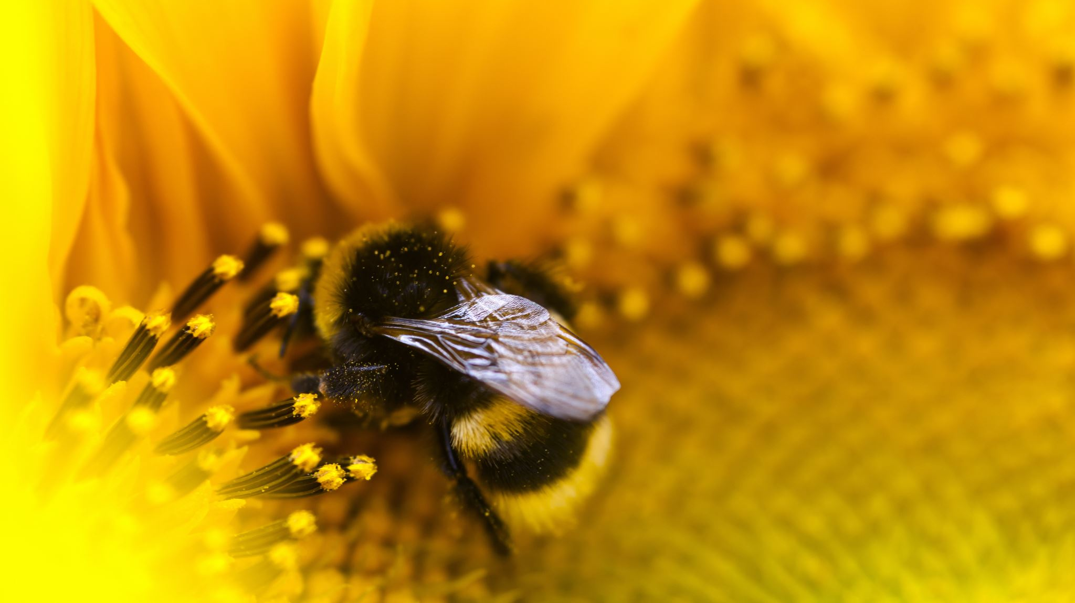
SABBATH KEEPING

Slide 2
1 Let us exalt the LORD today,
He who has wonders wrought
During this Holy Sabbath day,
Praise Him the Rod He brought.
Chorus:
We have a salve from our King,
Our eyes are now open,
It points to Sabbath keeping:
A foretaste of Eden.
.

Slide 3
2 Sing to the Lord of Sabbath praise,
Thank Him for old Eden,
‘Twill be restored in these our days,
For we are His children.
Chorus:
We have a salve from our King,
Our eyes are now open,
It points to Sabbath keeping:
A foretaste of Eden.
.

Slide 4
3 During the great and dreadful day,
Satan will show his wrath,
A final war, will not delay,
Against the true Sabbath.
Chorus:
We have a salve from our King,
Our eyes are now open,
It points to Sabbath keeping:
A foretaste of Eden.
.

Slide 5
4 Thanks for the saints scattered abroad,
Present truth family.
This Sabbath we learn from the Rod,
At Jesus’ feet gladly.
Chorus:
We have a salve from our King,
Our eyes are now open,
It points to Sabbath keeping:
A foretaste of Eden.
.

