Slide 1
A LITTLE SOLDIER

Slide 2
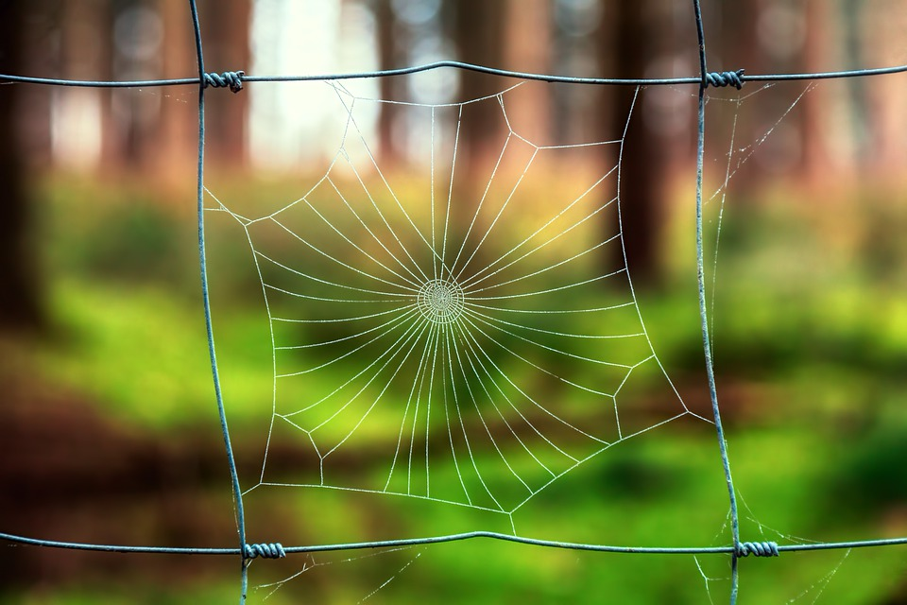
1 In the kingdom, which God shall set up,
Little children, little children shall be there.
And I will play on the hole of the asp,
The cow and the bear, pasture shall share.
Chorus: I'm a soldier, a little soldier,
In the army, in the army of the Lord.
Yes, a soldier, a little soldier,
In the Vanguard of the army of the Lord.

Slide 3
2 'Lesser cattle', refers to children,
And those newly come, newly come to the truth.
These may be treading, thus saith the Amen,
About the digged hills, that great day cometh.
Chorus: I'm a soldier, a little soldier,
In the army, in the army of the Lord.
Yes, a soldier, a little soldier,
In the Vanguard of the army of the Lord.

Slide 4
3 A great people, and a strong people,
There hath never been, hath never been the like.
They'll run to and fro, thus saith the Bible,
I want to be there, so sin I forsake.
Chorus: I'm a soldier, a little soldier,
In the army, in the army of the Lord.
Yes, a soldier, a little soldier,
In the Vanguard of the army of the Lord.

Slide 5
4 Jerusalem, the city of truth,
Shall be full of, shall be full of girls and boys.
They will be playing, full of joy and health,
In the streets thereof, God’s people rejoice.
Chorus: I'm a soldier, a little soldier,
In the army, in the army of the Lord.
Yes, a soldier, a little soldier,
In the Vanguard of the army of the Lord.

