Slide 1
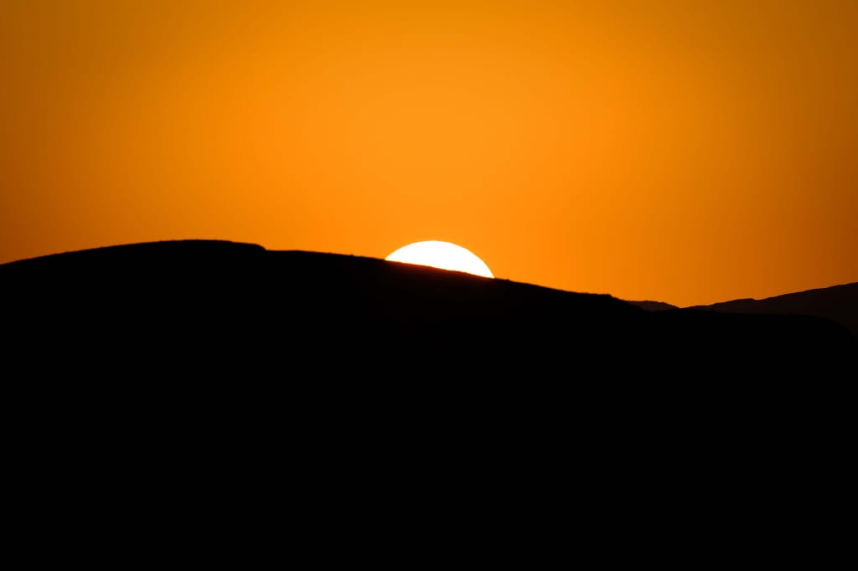
GET READY

Slide 2
1 The chariot came on the earth,
To bring us the Shepherd's Rod.
When its mission was over,
It got back into heaven.
It must come down again,
To do its second mission.
Only those who are ready,
Will board when the Angels shout: aboard!
Refrain: Get ready Davidians,
For the half-hour of silence,
Dear Laodiceans,
The second session will soon commence,
Oh gentiles , get ready,
The Loud Cry comes speedily,
Get ready! Get ready! Get ready!

Slide 3
2 Before the coming of Christ,
To purify His Temple,
He will delegate a man,
To reign over His people;
This man will sweep false doctrines,
The pure Rod he will proclaim,
Only those who are ready,
Will let this man to reign over them.
Refrain: Get ready Davidians,
For the half-hour of silence,
Dear Laodiceans,
The second session will soon commence,
Oh gentiles, get ready,
The Loud Cry comes speedily,
Get ready! Get ready! Get ready!

Slide 4
3 To save the Davidian church,
The Lord will send a shepherd,
For the Laodicean church,
He will employ the vanguard;
To save those in Babylon,
First fruits with authority,
Are sent to the ready ones, Who’ll honor the opportunity.
Refrain: Get ready Davidians,
For the half-hour of silence,
Dear Laodiceans,
The second session will soon commence,
Oh gentiles, get ready,
The Loud Cry comes speedily,
Get ready! Get ready! Get ready!

