Slide 1
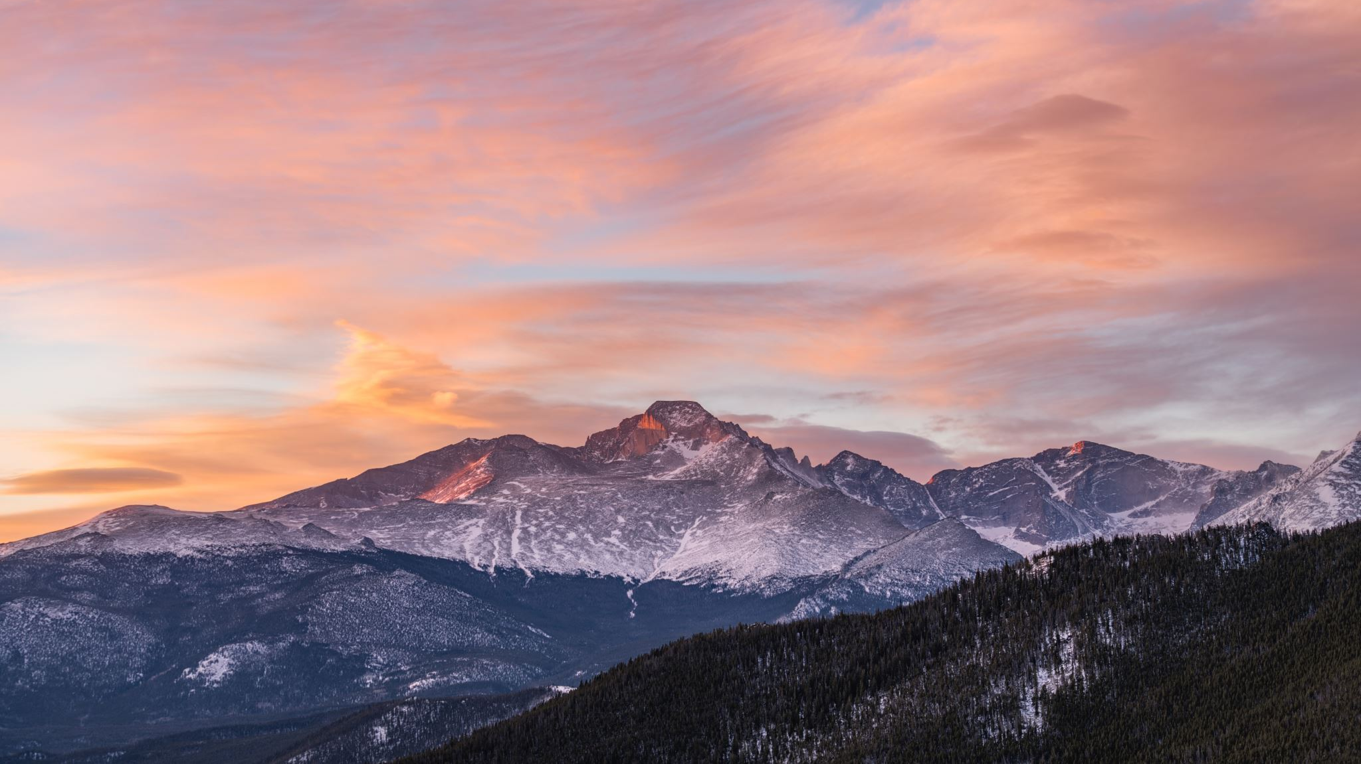
MY SHEEP WANDERED

Slide 2
1 Through all mountains My sheep wandered,
And upon every high hill;
No one sought them as they sundered,
Here is what God will fulfill:
‘I will search them, I will bring them,
By the hand of My chosen,
King David,’ I have spoken.

Slide 3
2 What a multitude of shepherds,
For so long have left undone,
David who’ll replace these cowards,
In God’s hands will get it done.
All unfaithful, All unworthy;
Answer to God’s questioning,
On the day of reckoning.

Slide 4
3 In the days of this king David,
God gathers us by His hand,
The exodus will be splendid,
We will go to our own land.
Seed of Israel, seed of Judah,
Shall be gathered and be fed,
By their one appointed head.

Slide 5
4 This David is first a shepherd,
Soon he will be crowned as king,
Crystal clear, let this truth be heard,
That he restores everything.
Soon the pilgrims, soon the captives,
In Jerusalem rejoice,
With their heart and soul and voice.

