Slide 1
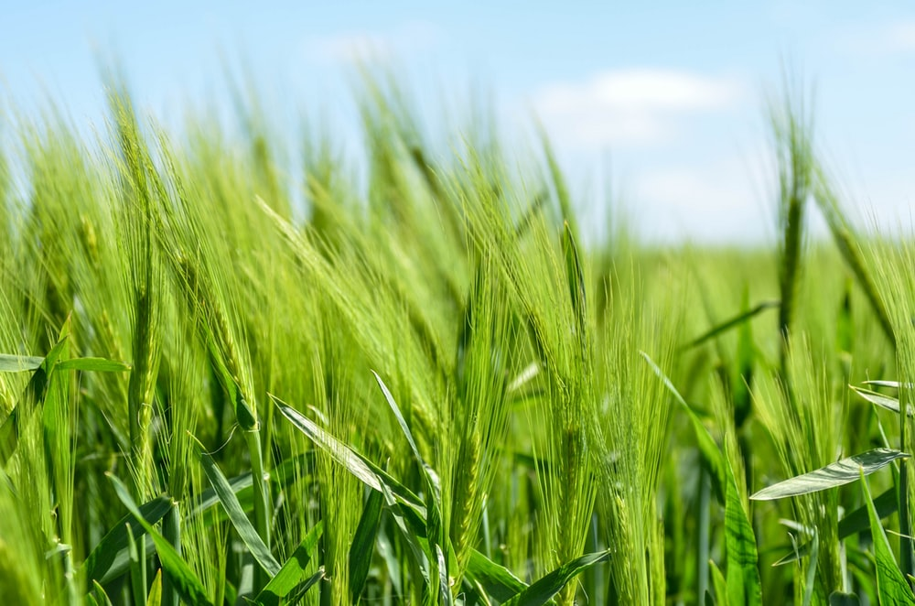
SOWING
THE SEED

Slide 2
1 Are you sowing the seed of the kingdom, brother?
In this very late probation hour?
Are you sowing the seed of the kingdom, brother?
Do you do the will of our Savior? Chorus: For the harvest time is coming on,
And the angels will reap soon,
A work terrible, it is the mighty sifting,
In the judgment time of the living.

Slide 3
2 Are you sowing the seed in your heart my brother?
Are you truly sighing and crying?
Are you sowing the seed in your heart my brother?
Are you reforming and repenting? Chorus: For the harvest time is coming on,
And the angels will reap soon,
A work terrible, it is the mighty sifting,
In the judgment time of the living.

Slide 4
3 Are you sowing the seed each moment, O brother?
Are you winning souls for Christ this year?
Are you sowing the seed each moment, O brother?
Have you a burden for souls so dear? Chorus: For the harvest time is coming on,
And the angels will reap soon,
A work terrible, it is the mighty sifting,
In the judgment time of the living.

Slide 5
4 Are you sowing the seed in your speech my brother?
Do you have any guile in your mouth?
Are you sowing the seed in your speech my brother?
Do you say nothing but the pure truth? Chorus: For the harvest time is coming on,
And the angels will reap soon,
A work terrible, it is the mighty sifting,
In the judgment time of the living.

Slide 6
5 Are you sowing the seed oh Davidian brother?
Do you have with you the extra oil?
Are you sowing the seed oh Davidian brother?
Virgins wise are those who will prevail?
Chorus: For the harvest time is coming on,
And the angels will reap soon,
A work terrible, it is the mighty sifting,
In the judgment time of the living.

