Slide 1
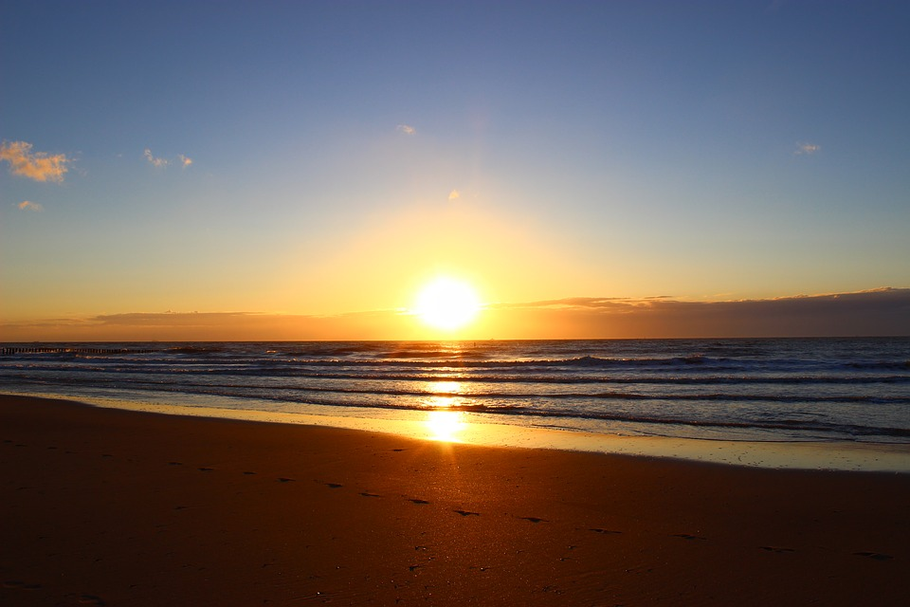
The Kingdom draweth nearer

Slide 2
1 Behold the Kingdom cometh, where Jesus holdeth sway,
He is the Lord of glory, and soon He shall appear.
Lo, in His glorious Chariot, He will descend that day,
Get ready, make the Lord now, your one and only fear.
Refrain The Kingdom draweth nearer,
May God to you be dearer,
Shine forth your new light clearer,
The Kingdom is nearer.

Slide 3
2 Behold Elijah cometh, to bring the message home,
Before the Lord returneth, He will prepare the way.
His message is for this time, a message of reform,
Get ready, that day is nigh, the great and dreadful day.
Refrain The Kingdom draweth nearer,
May God to you be dearer,
Shine forth your new light clearer,
The Kingdom is nearer.

Slide 4
3 Behold the bridegroom cometh, the guests to examine,
Brother, sister, do you have, the wedding garment on?
It is a pure character; spotless and so divine,
Get ready and have it on, for soon the day will dawn.
Refrain The Kingdom draweth nearer,
May God to you be dearer,
Shine forth your new light clearer,
The Kingdom is nearer.

Slide 5
4 Behold King Jesus cometh, to reign here gloriously,
Thousands of angels with Him, He’ll judge all the living.
His church will preach the Loud Cry, to gentiles valiantly,
Get ready dear beloved, the Kingdom is coming.
Refrain The Kingdom draweth nearer,
May God to you be dearer,
Shine forth your new light clearer,
The Kingdom is nearer.

