Slide 1
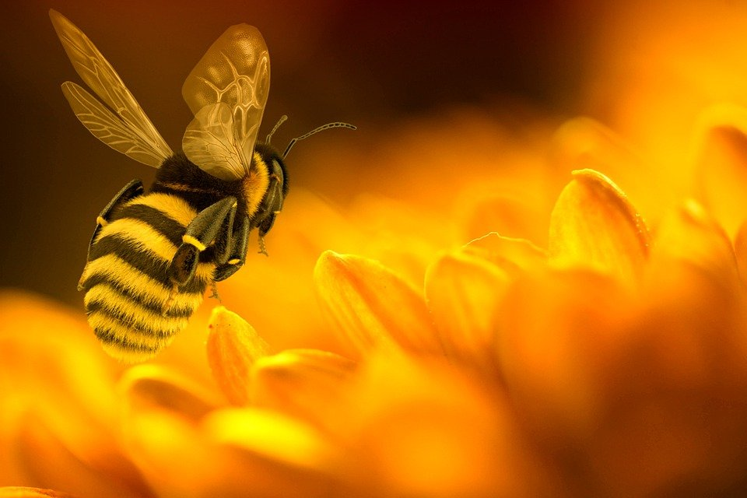
WE, QUEEN ESTHERS
ALL QUEENS ARISE!

Slide 2
1
We, Queen Esthers love Our God,
Serving Him gives joy untold,
Like Hannah we persevere,
Praying, fasting, being sincere;
To Christ’s honor, we sisters,
Beautify His crown with stars,
With the Spirit in our heart,
We are women wondered at.

Slide 3
2
There are gems of truth we hold,
Learnt from the women of old,
Like Miriam the prophetess,
God’s shepherd we’ll help and bless;
We are never time wasters,
Proverbs thirty-one sisters,
The Word tells us of Dorcas,
Her good works we may surpass.

Slide 4
3
Queen Esther’s society,
Ruled by faith and piety,
We will dress to God’s honor,
Keep clean, with sound demeanor;
We’ll learn healthy cookery,
And bake our bread properly,
In our homes bring warmth and love,
Caring, tender like a dove.

Slide 5
4
The Rod gives us courage great,
Like Esther to operate,
If we perish, we perish,
To please Christ; our only wish;
We should be virtuous women,
Helping children, youths and men,
Being firm like Sister White,
God grant vict’ry in our fight.

