Slide 1
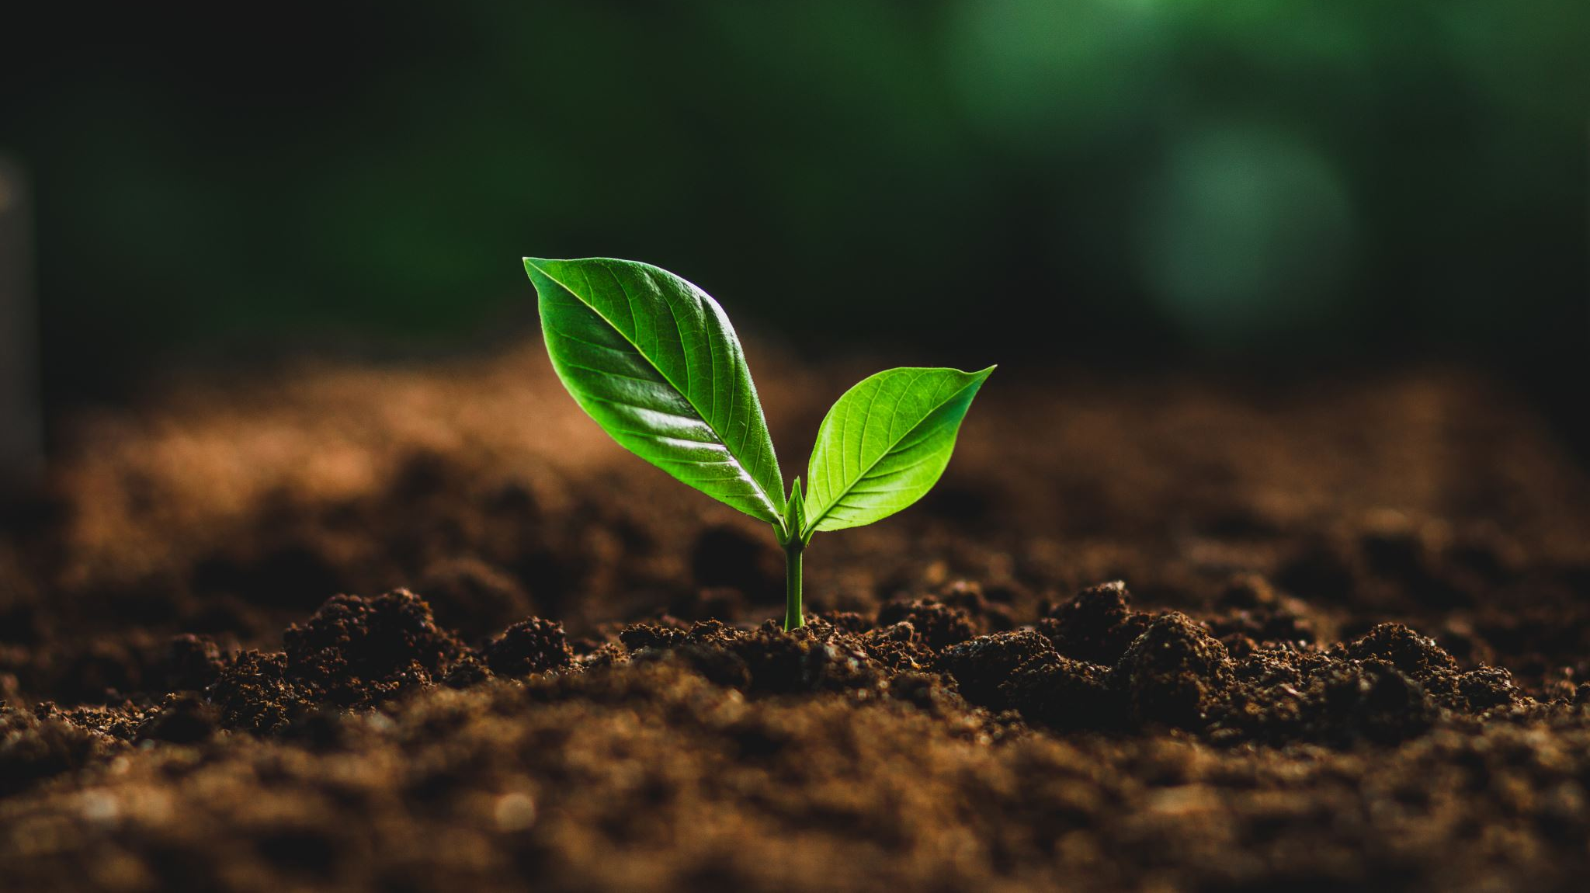
THERE
COMETH A TIME

Slide 2
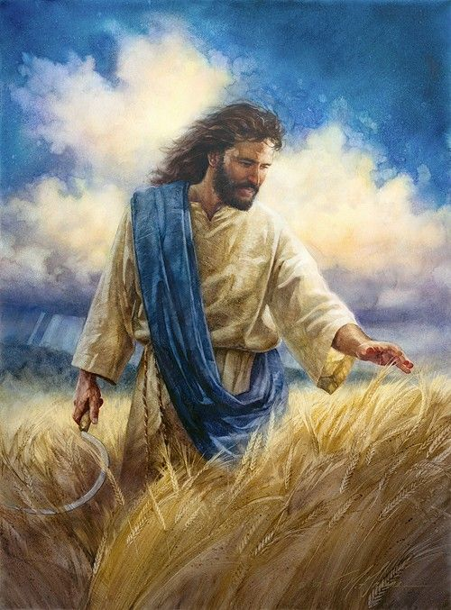
1 There cometh a time, when sorrow will cease,
When there’ll be no more sinners, no more disease.
Bliss eternally, In that Kingdom land,
Oh joy that is precious, to the holy band.
Refrain: What joy that will be, in the glorious home,
No pain, no more fear, Christ wipes every tear;
A new heart we’ll get, His will to perform,
Redemption tune will ring: All hail to our King!

Slide 3
2 The living righteous, and the risen saints,
And those in heaven, will meet; no more constraints.
These three groups will meet, in the promised land,
Then march to paradise, with Christ in command.
Refrain: What joy that will be, in the glorious home,
No pain, no more fear, Christ wipes every tear;
A new heart we’ll get, His will to perform,
Redemption tune will ring: All hail to our King!

Slide 4
3 Striving now to be, among the first fruits,
One forty-four thousand, of Davidic roots.
The first of first fruits; the Vanguard of God,
By grace we shall be there, help us, faithful Lord..
Refrain: What joy that will be, in the glorious home,
No pain, no more fear, Christ wipes every tear;
A new heart we’ll get, His will to perform,
Redemption tune will ring: All hail to our King!

