Slide 1
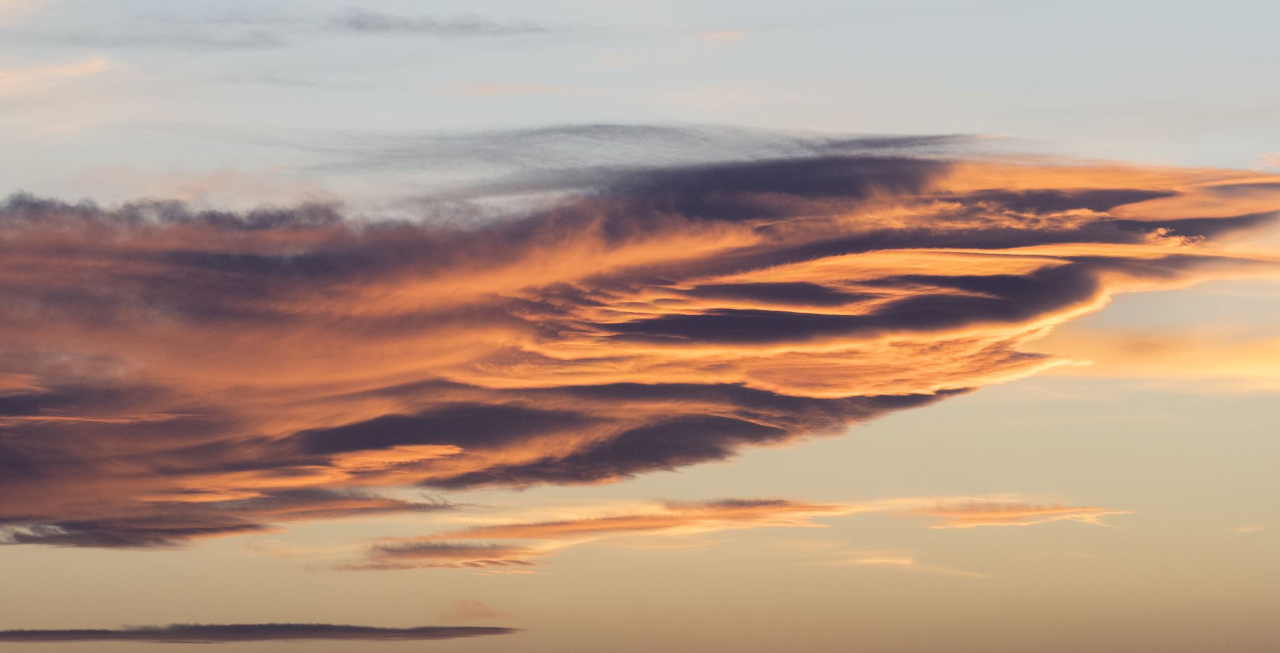
THERE IS A KINGDOM

Slide 2
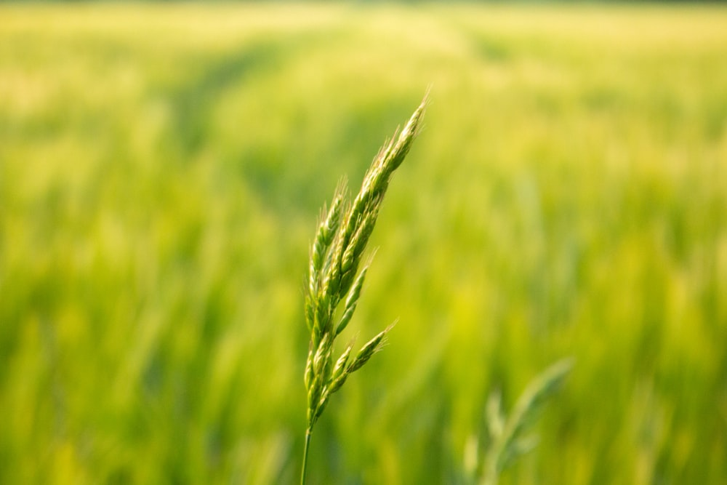
1 There is a Kingdom made for us:
No tongue can tell the joy,
There the dwellers all live in love,
And peace forever more,
And peace forever more,
And peace forever more,
There the dwellers all live in love,
And peace forever more.

Slide 3
2 Mount olive then shall break in two;
Form a valley so great,
By Jesus feet standing on it,
Oh what a great event!
Oh what a great event!
Oh what a great event!
By Jesus feet standing on it,
Oh what a great event!

Slide 4
3 On Mount Zion we are to stand,
With Jesus Christ our Lord,
Tarrying ten days till Pentecost;
Oh what a glorious thought!
Oh what a glorious thought!
Oh what a glorious thought!
Tarrying ten days till Pentecost;
Oh what a glorious thought!

Slide 5
4 A Heart of flesh God shall give us,
To sin again no more,
And doing good shall be our joy;
We shall delight in peace.
We shall delight in peace.
We shall delight in peace.
And doing good shall be our joy;
We shall delight in peace.

Slide 6
5 There in our land no tears shall fall;
Nor pain nor sickness heard,
And the evils so rampant now,
Shall not be done in there,
Shall not be done in there,
Shall not be done in there,
And the evils so rampant now,
Shall not be done in there.

Slide 7
6 Then we’ll behold the Lord descend,
For His redeemed trophies,
In His splendid Second Coming,
Oh, what triumphant joy!
Oh, what triumphant joy!
Oh, what triumphant joy!
In His splendid Second Coming,
Oh, what triumphant joy!

