Slide 1
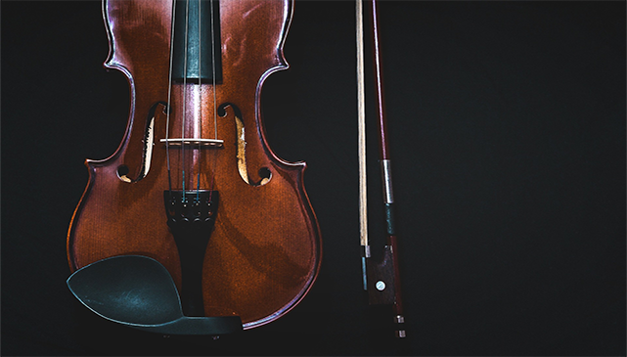
Day of Days

Slide 2
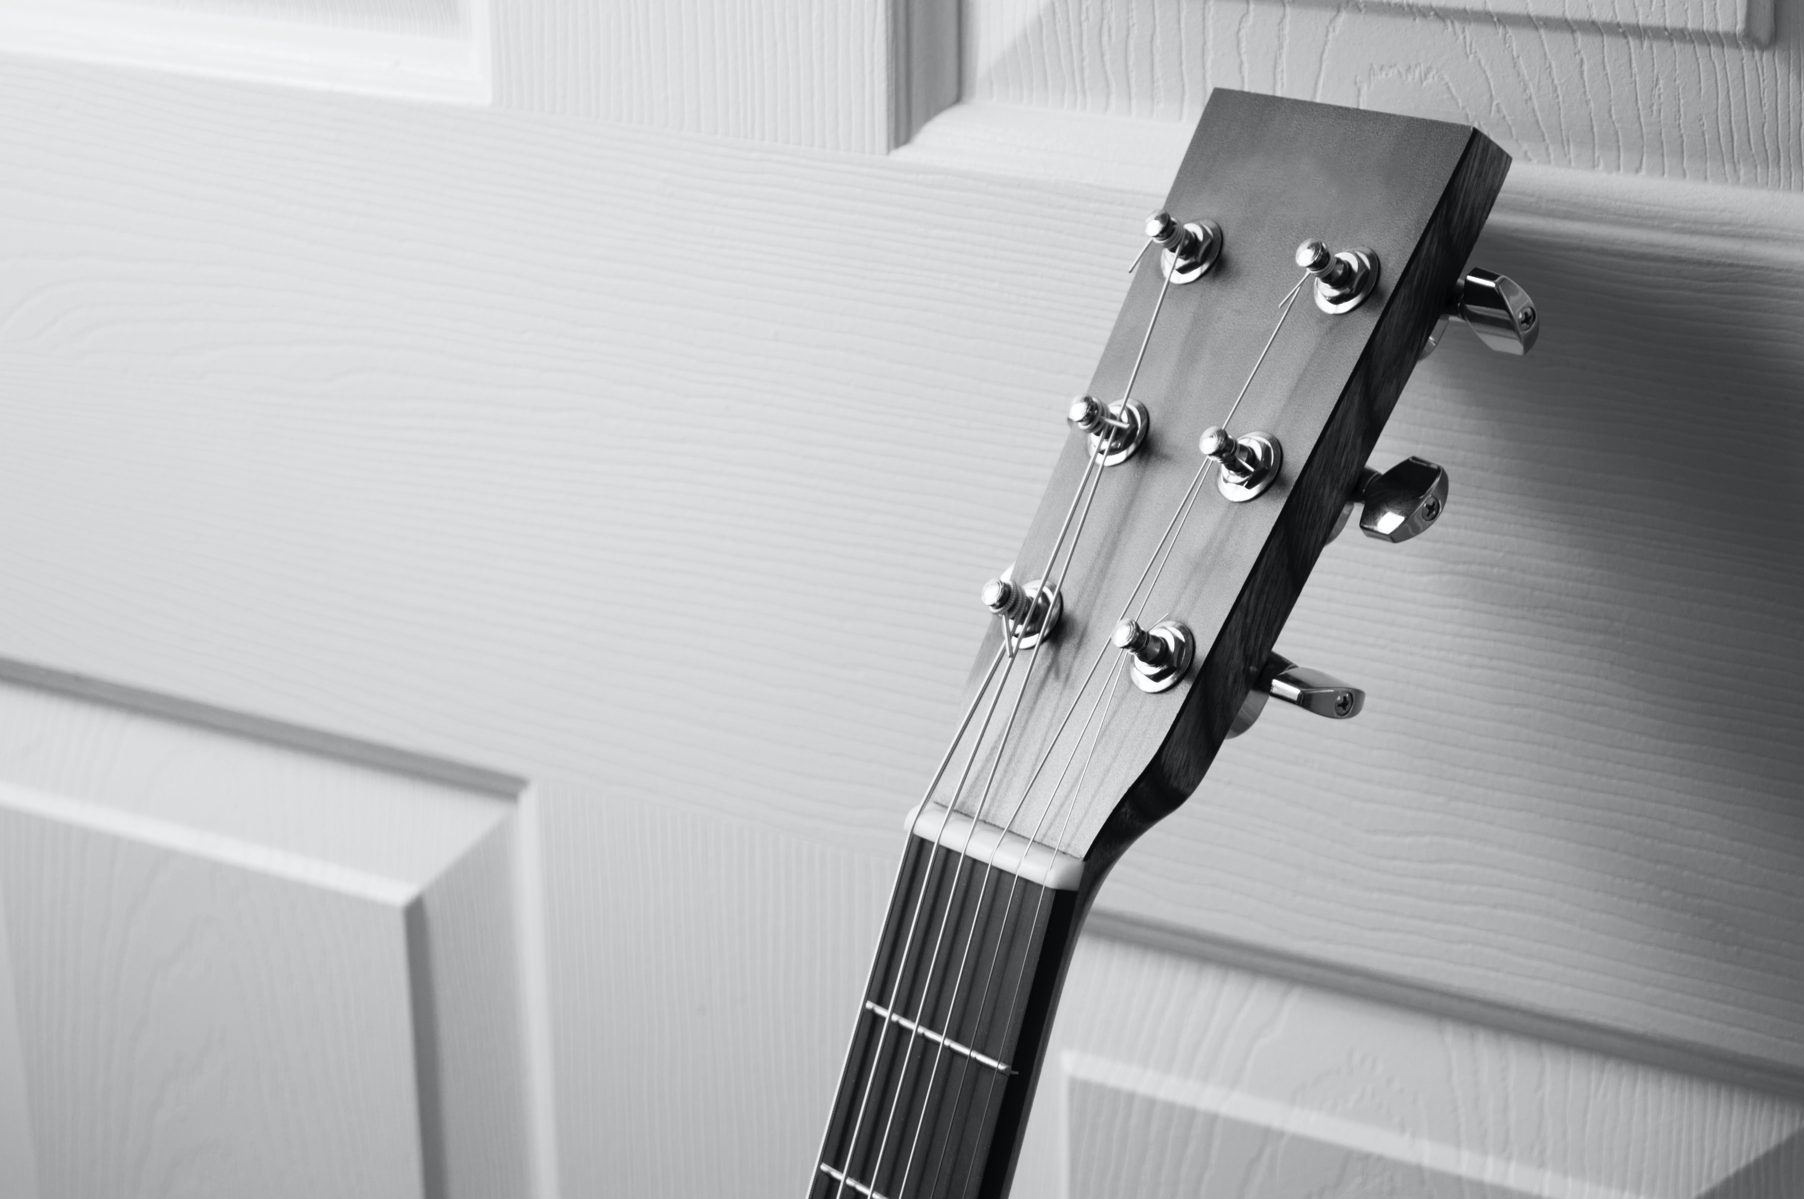
1 We again stand at the threshold,
Of the beginning of Days,
Having spent this year we behold,
Solemnly all our past ways.
Looking forward now in vision,
To what we may all become,
Day of praises with devotion,
To God from whom mercies come.

Slide 3
Refrain Day of days, Day of days,
Twenty-fifth of October,
Day of days, Day of Days,
A day of reckoning.

Slide 4
2 With faith and joy superlative,
We resolve to do God’s ways,
Our progress will be redemptive,
Truly it’s our day of days.
Oh Lord grant that of all so far,
This may be most inspiring,
Day most memorable pillar;
Present truth histories ring.

Slide 5
Refrain Day of days, Day of days,
Twenty-fifth of October,
Day of days, Day of Days,
A day of reckoning.

Slide 6
3 Ask yourself how you have progressed,
In serving the LORD, dear friend,
In your area, have you espoused,
Duties that to you extend,
Saint aim to hasten the Kingdom,
By not wasting precious time,
Praying this day for God’s wisdom,
Day of days, the most sublime.

Slide 7
Refrain Day of days, Day of days,
Twenty-fifth of October,
Day of days, Day of Days,
A day of reckoning.

