Slide 1
GREAT IS THE SHEPHERD’S ROD TO ME

Slide 2
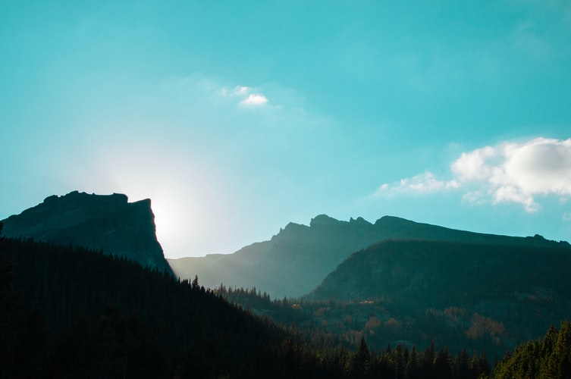
1
Great is the Shepherd Rod to me,
‘Tis meat in due season,
From sin, this message sets me free,
Guides on like a beacon.
It teaches me to live aright,
And makes my heart to delight,
Shows the timeline to the Kingdom,
Revealing God’s Wisdom.

Slide 3
2
It shows the number of the saints,
One forty-four thousand,
These first fruits have no sinful taints,
On mount Zion they stand.
They have no fault, are pure in heart,
And they are men wondered at,
In their mouth, they do not have guile,
They save Jew and gentile.

Slide 4
3
Study the pure Rod and obey,
That you may be ready,
For the great and terrible day,
Apply this remedy.
'Twill be dreadful for the wicked,
Who will never be fitted,
For translation as will the saints,
A great blessing awaits.

