Slide 1
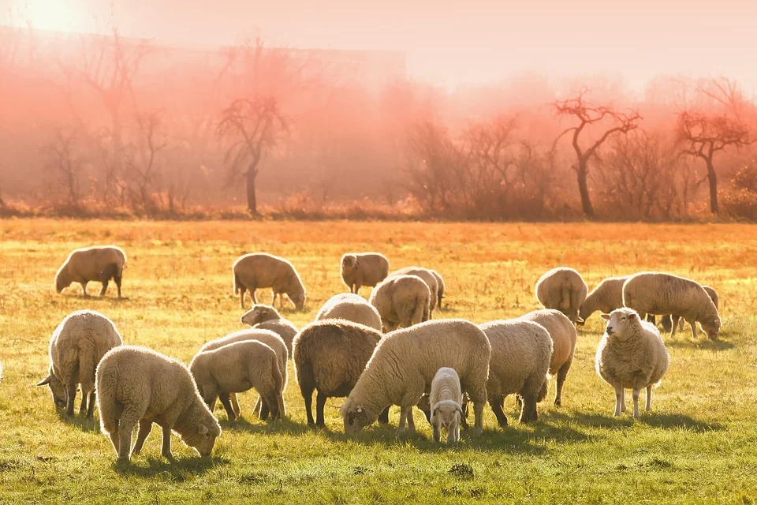
HEED THE ROD

Slide 2
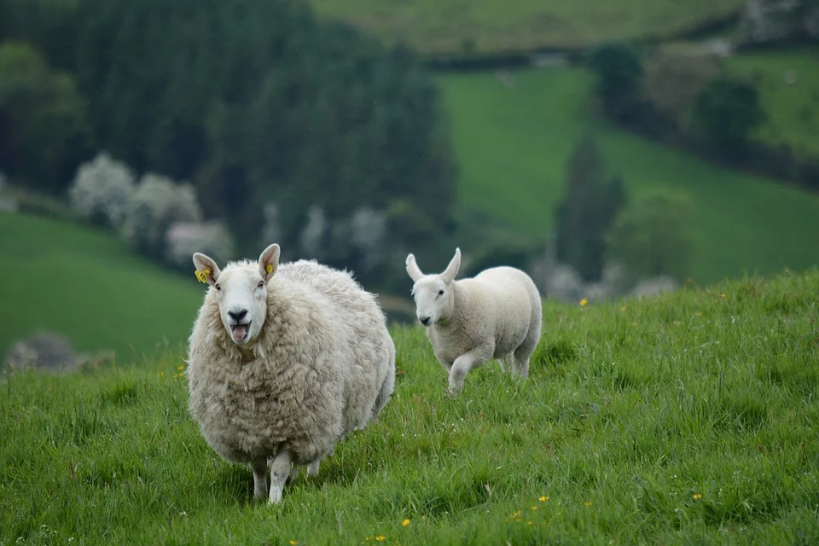
1 We've a latter rain message, sing hosanna!
The judgment of the living message today,
It's the present truth message, sing hosanna!
Meant for all the saints who study, watch and pray.
Chorus: Heed the Rod!
Shepherd's Rod!
Truth that sets you free,
Study it and get the salve that you may see.

Slide 3
2 It is meant for families, what a promise!
Uniting the parents to their own children,
It will bring reformation, what a promise!
Faithfully knitting the hearts of all brethren.
Chorus: Heed the Rod!
Shepherd's Rod!
Truth that sets you free,
Study it and get the salve that you may see.

Slide 4
3 We've a message of warning, stop and listen!
Given by the God of Lights, receive each ray,
It prepares the saints on earth, stop and listen!
For the coming of the great and dreadful day.
Chorus: Heed the Rod!
Shepherd's Rod!
Truth that sets you free,
Study it and get the salve that you may see.

