Slide 1
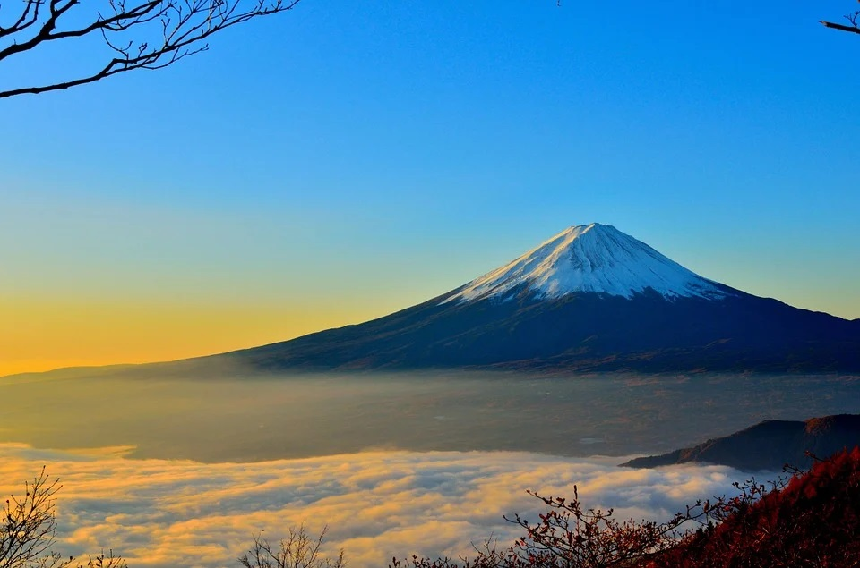
THANK HIM FOR THE YEAR OF THE REDEEMED

Slide 2
1 Oh, how great is He who keeps the promises,
Until they are all realized.
Elijah to us He’ll send,
Errors paralyze,
The Rod and truth defend.
Refrain: Oh, I thank Him, thank the Lord,
For the year of the redeemed;
Yes, I thank, I thank the great God,
Canaan will be reclaimed.

Slide 3
2 Oh, I thank Him for he has promised David,
Unfaithful shepherds to succeed;
When he comes he’ll take the host,
And them he will feed,
Filled with the Holy Ghost.
Refrain: Oh, I thank Him, thank the Lord,
For the year of the redeemed;
Yes, I thank, I thank the great God,
Canaan will be reclaimed.

Slide 4
3 Oh, how great is He who has redeemed the flock,
From the dangerous deception;
Now by faith forward we press,
And hope to attain,
His perfect righteousness.
Refrain: Oh, I thank Him, thank the Lord,
For the year of the redeemed;
Yes, I thank, I thank the great God,
Canaan will be reclaimed.

Slide 5
4 Yes, I worship Thee Majesty of heaven,
For you will destroy Babylon,
In the judgment now not far,
His saints travel on,
As they come out of her.
Refrain: Oh, I thank Him, thank the Lord,
For the year of the redeemed;
Yes, I thank, I thank the great God,
Canaan will be reclaimed.

