Slide 1
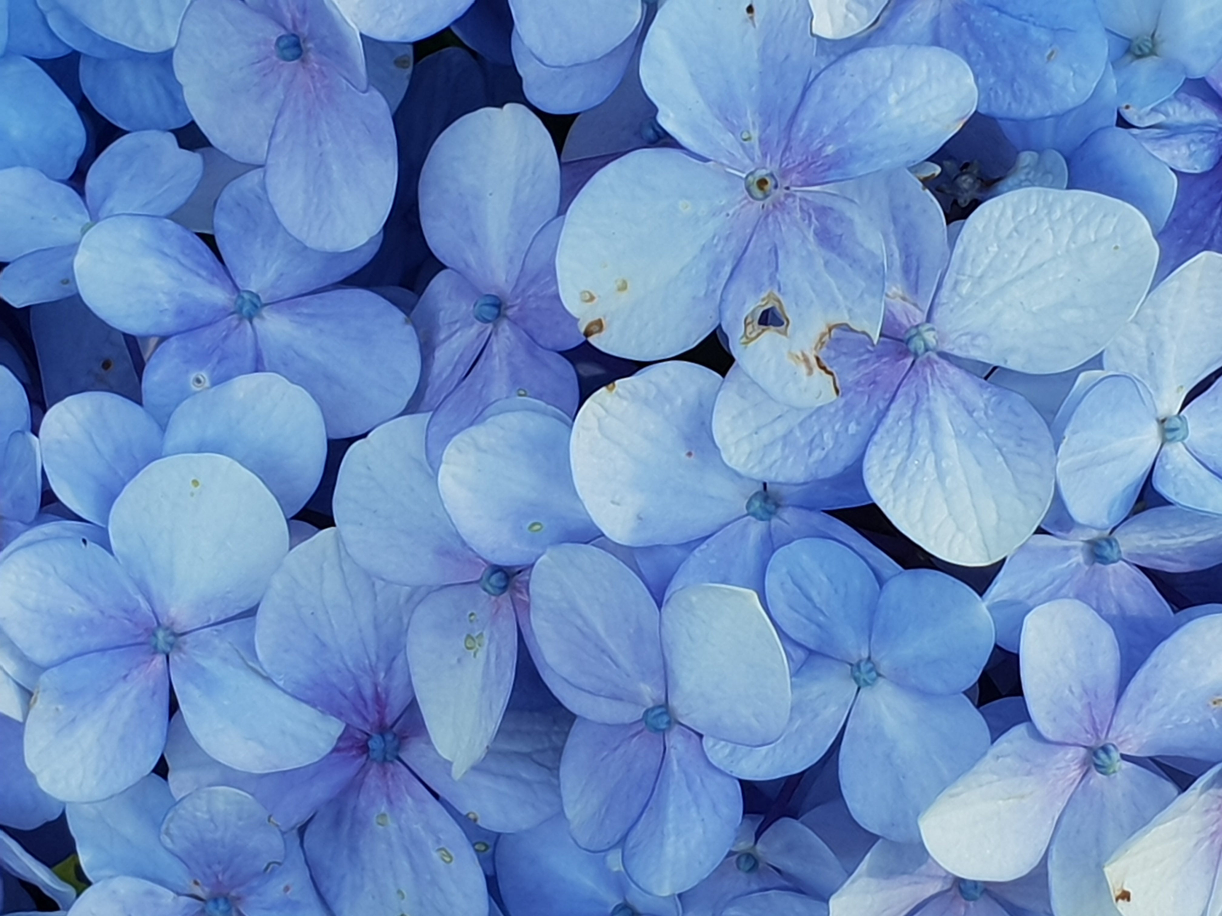
LET THE CHILDREN COME

Slide 2
1
Unto Jesus were brought little children,
That He should put His hands on them and pray,
He being so kind and gentle to all men,
Calling for them, the Loving Lord did say:
Refrain:
Let the children, come unto me,
Forbid them not, forbid them not,
For of such is, and they will see,
The Kingdom of heaven.

Slide 3
2
With sympathy, Jesus heard the request,
But the mothers were quickly sent away,
This was unto the disciples a test,
He was displeased with them and so did say:
Refrain
Let the children, come unto me,
Forbid them not, forbid them not,
For of such is, and they will see,
The Kingdom of heaven.

Slide 4
3
Then in His arms, Jesus took the children,
Gave them the blessing, as He does today,
Oh dear mother, Jesus knows the burden,
That's in your heart, so hear the Saviour say:
Refrain
Let the children, come unto me,
Forbid them not, forbid them not,
For of such is, and they will see,
The Kingdom of heaven.

Slide 5
4
Soon we'll be there, in the holy mountain,
The calf, young lion, and a child shall play,
He who has childlike faith will enter in,
And this is why the loving Lord did say:
Refrain
Let the children, come unto me,
Forbid them not, forbid them not,
For of such is, and they will see,
The Kingdom of heaven.

