Slide 1
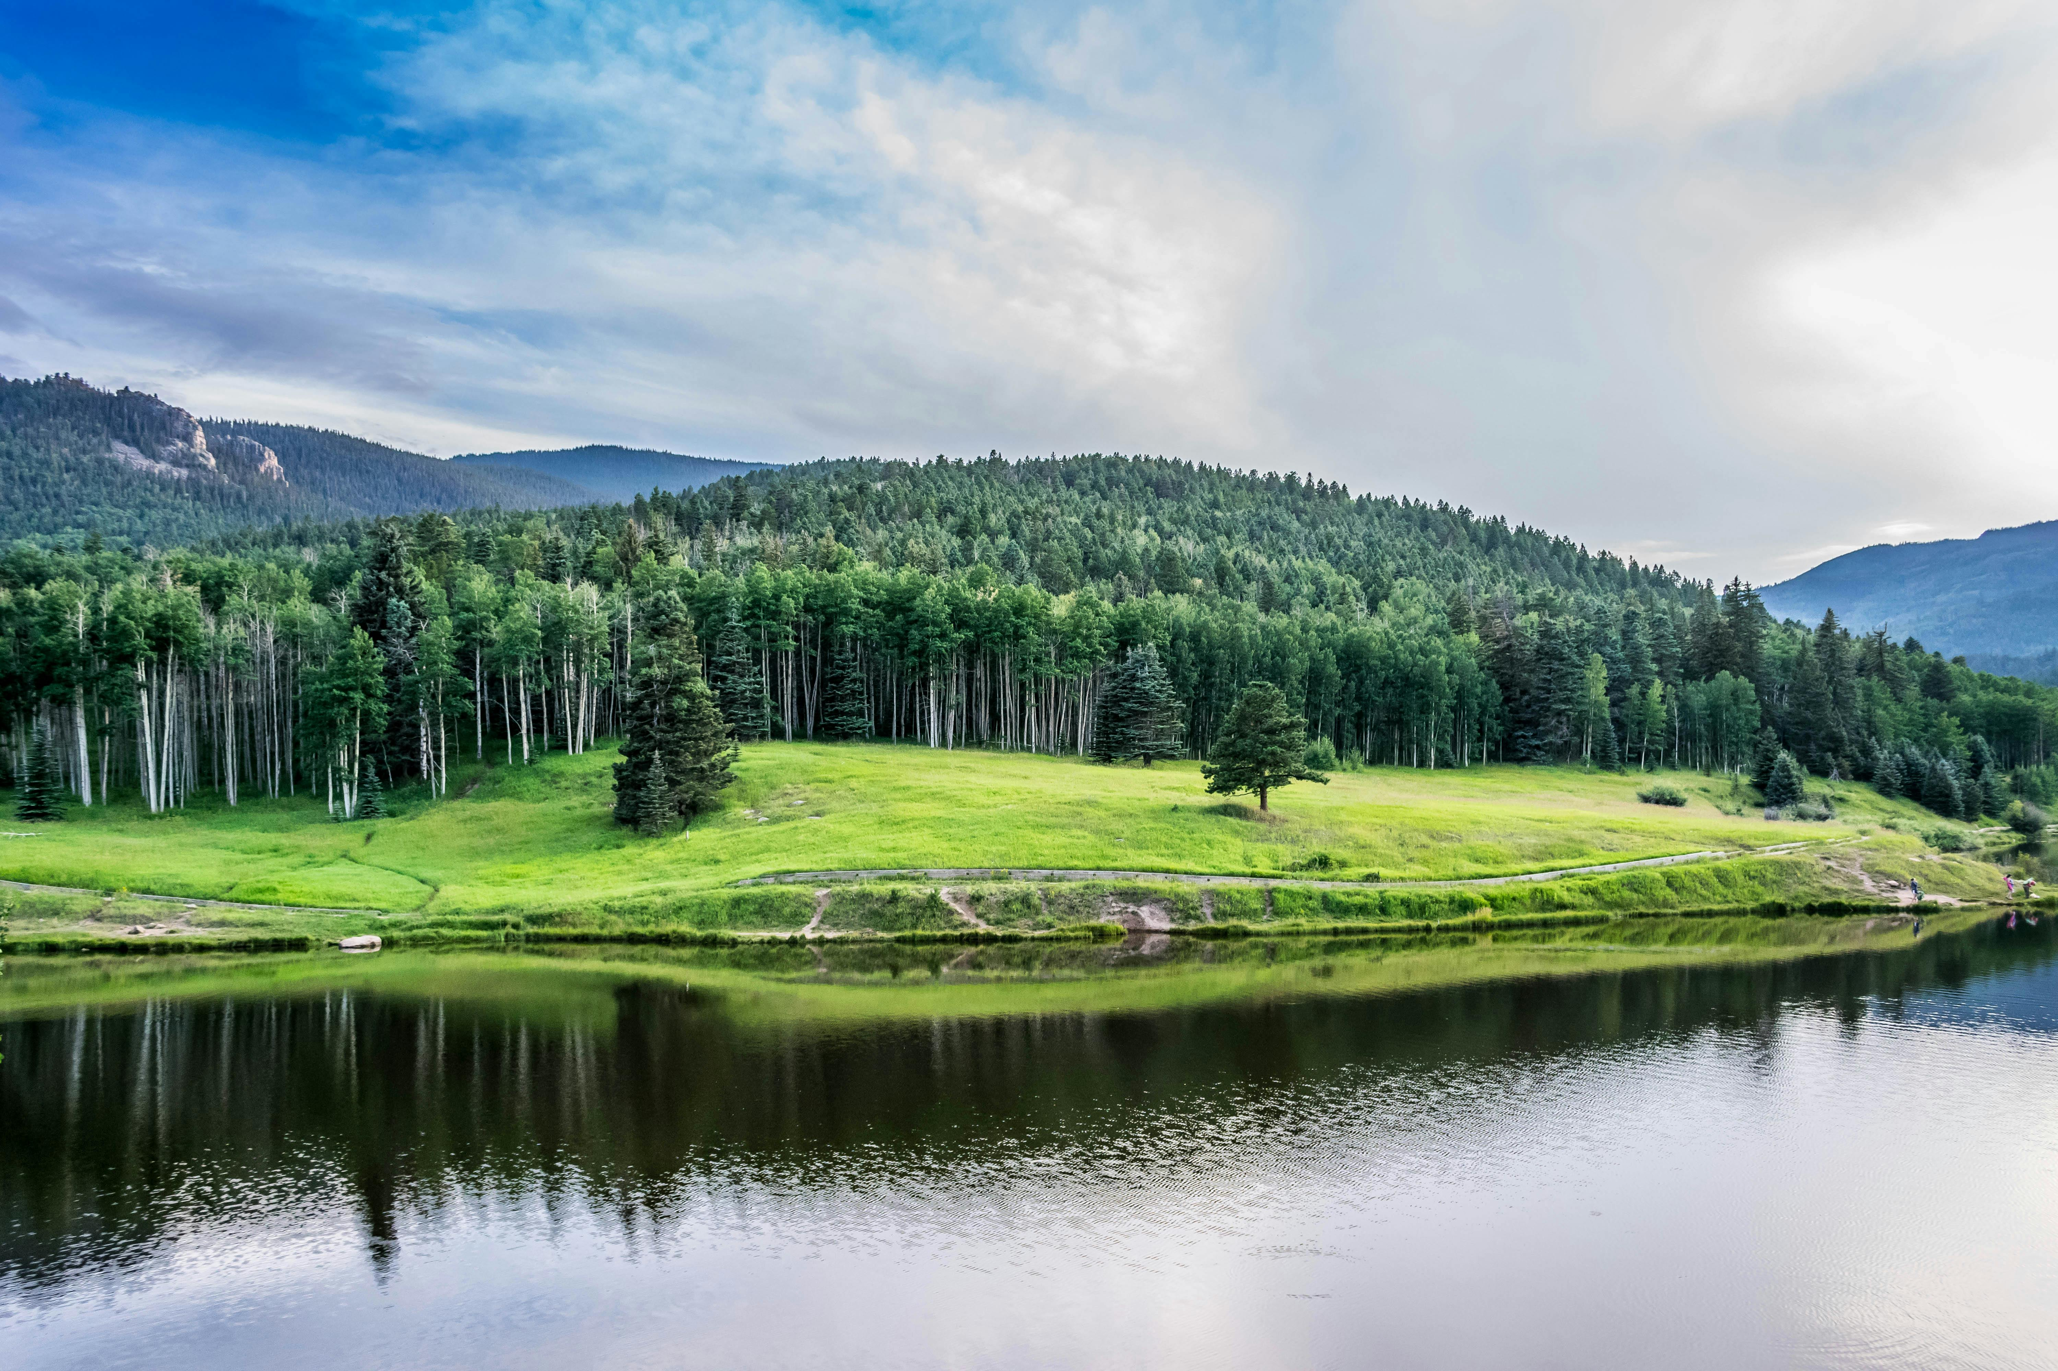
LETS KEEP THE
SABBATH DAY

Slide 2
1
My dear lovely parents,
Let’s keep the Sabbath Day,
God gave it, I love it,
I delight to obey.

Slide 3
2
My dear lovely parents,
Let’s keep the Sabbath Day,
God gave it, I love it,
I delight to obey.

Slide 4
3
On sabbath I will pray,
And listen to God speak,
“God,” I pray, “lead the way,
To Thee I’ll closely stick”

