Slide 1
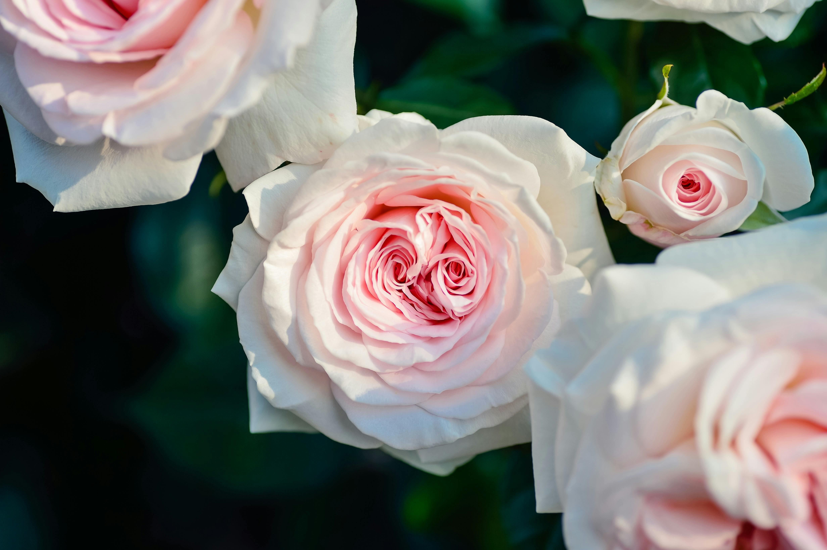
TEN VIRGINS

Slide 2
1 The Kingdom of heaven is like,
Ten virgins with lamps in a room,
They went forth to meet the bridegroom,
Five virgins wise, and five foolish,
Five virgins wise, and five foolish.

Slide 3
2 They that were foolish took their lamps,
And took no oil along with them,
But the wise took the oil with them,
This oil is additional truth,
This oil is additional truth.

Slide 4
3 While the Bridegroom tarried, they slept,
And at midnight there was a cry,
Behold the Bridegroom draweth nigh,
Go ye! go ye! out to meet Him,
Go ye! go ye! out to meet Him.

Slide 5
4 Upon hearing the midnight cry,
They all trimmed their lamps and did rise,
The foolish said unto the wise,
Give us some oil, our lamps are off,
Give us some oil, our lamps are off.

Slide 6
5 The wise answered saying, Not so,
Twill not suffice, to serve you well,
Go ye rather to them that sell,
And buy this oil of present truth,
And buy this oil of present truth.

Slide 7
6 While they went to seek present truth,
The bridegroom came, the door was shut,
The wise went in with joy in heart,
Today hear ye the Spirit's Voice,
Today hear ye the Spirit's Voice.

Slide 8
7 Later came also the foolish,
“Lord, Lord, open to us!” They pled.
But the Bridegroom, answered and said,
“I say to you, I know you not!”
“I say to you, I know you not!”

Slide 9
8 Watch ye therefore servants of God,
The day and hour, no man knoweth,
Wherein the Son of man cometh,
He comes to judge all the living,
He comes to judge all the living”

