Slide 1
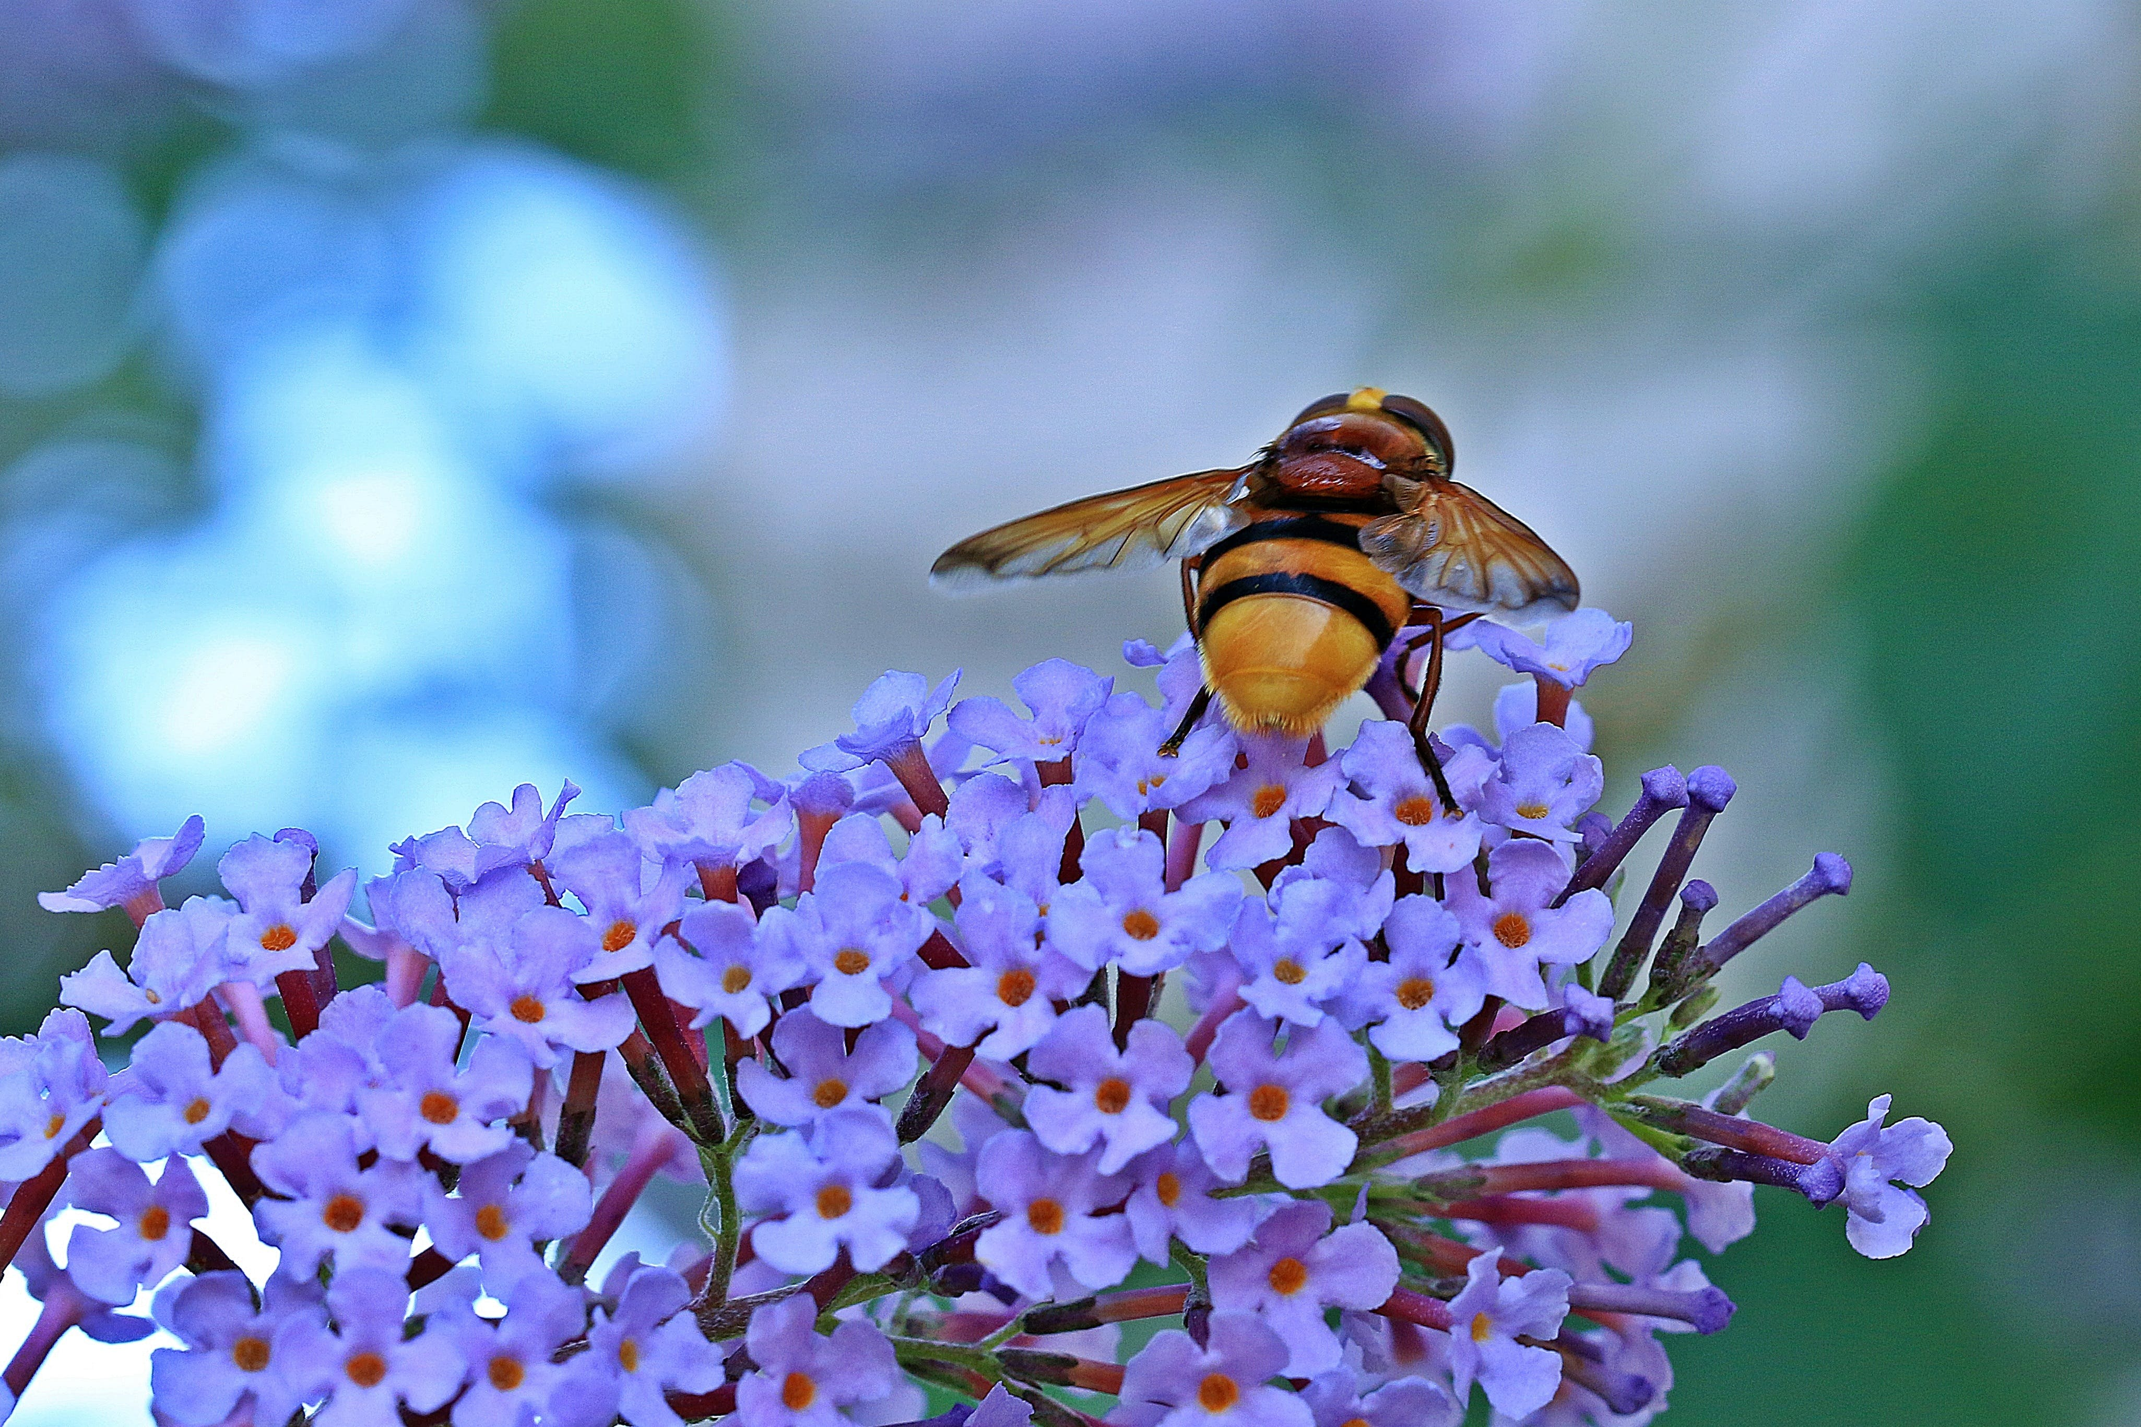
THE KINGDOM TRUTH

Slide 2
1 The kingdom truth to me is sweet,
Great comfort it hath wrought,
Obedience to it makes me wheat,
And uplifts every thought.
2 O treasure this truth like a pearl,
For it is Christ in word,
Like Elijah at mount Carmel,
Its power is fire and sword.

Slide 3
3 My brother have your heart made new,
Heed the truth, oh make haste,
The Shepherd’s Rod is for the few,
In God’s Kingdom you’ll rest.
4 Davidians know this truth is clear,
All God says is obey,
Add not, take not, obey in cheer,
Feast on this meat today.

Slide 4
5 Lord, God of hosts, receive my soul,
I owe my life to thee,
Help me sincerely heed the call,
Thy face I want to see.

