Slide 1
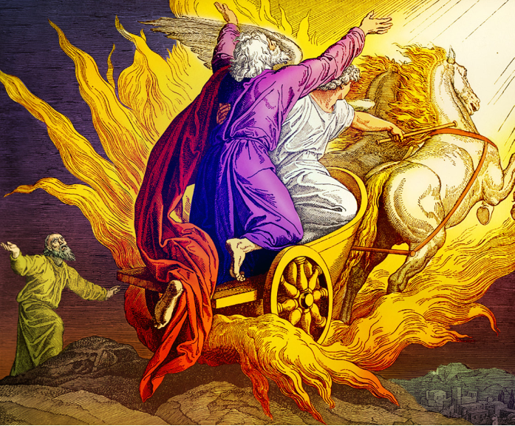
VTC ANTHEM

Slide 2
1
Vanguard Academy we stand,
With Jesus Christ as our guide,
We strive to learn and understand,
As the Spirit in us abides.

Slide 3
2
From every corner of the land,
We are here to grow and be blest;
And our teachers do firmly stand,
In guiding us to do our best.

Slide 4
3
With knowledge, wisdom and power,
We will go forth and conquer all,
We’re nurtured in this Eleventh hour,
For the Kingdom where we’ll soon go.

Slide 5
4
We thank this academy of love,
Where God’s tender mercy abounds,
The lessons taught us from above,
Bear witness to this blessed ground.

