Slide 1
THE NEWSTART HYMN

Slide 2
1. The Great Physician now is near,
Our sympathizing Jesus;
The health reform He’s given us,
For wholesome strength and good cheer. Chorus: Obey now all the health laws,
Obey now the Rod message,
Living by reforms revealed,
Only power of healing.

Slide 3
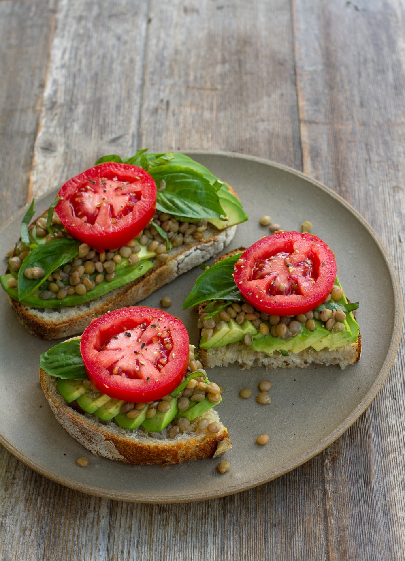
2. Learning to make nutritious food,
Saves many souls we’re losing;
We should steer clear of poor cooking,
A sacred duty so good.
Chorus: Obey now all the health laws,
Obey now the Rod message,
Living by reforms revealed,
Only power of healing.

Slide 4
2. Each day you need sufficient rest,
Sunshine, fresh air and water;
Exercise is a great matter,
Be temperate and be honest.
Chorus: Obey now all the health laws,
Obey now the Rod message,
Living by reforms revealed,
Only power of healing.

Slide 5
4. We should on time amend our ways,
Trusting in God for support;
Let every deed and word and thought,
Reveal the Saviour always.
Chorus: Obey now all the health laws,
Obey now the Rod message,
Living by reforms revealed,
Only power of healing.

Slide 6
Chorus: Obey now all the health laws,
Obey now the Rod message,
Living by reforms revealed,
Only power of healing.
N – Nutrition E – Exercise W – Water S – Sunshine
T – Temperance A – Air R – Rest T – Trust in God

